Slide 1
CULTIVATED LAND
FIELD CROPS AND TEMPORARY MEADOWS
by Anita Van Quynh, Pierre Barré
& l'équipe d'animation de FairCarboN

Slide 2
SOMMAIRE
CULTIVATED LAND
FIELD CROPS AND TEMPORARY MEADOWS
1.
ECOSYSTEM OVERVIEW: DEFINITIONS AND KEY FIGURES
2.
STOCKS AND FORMS OF ORGANIC CARBON
3.
ORGANIC CARBON DYNAMICS
4.
LEVERS FOR CARBON STORAGE
5.
Conclusions

Slide 3
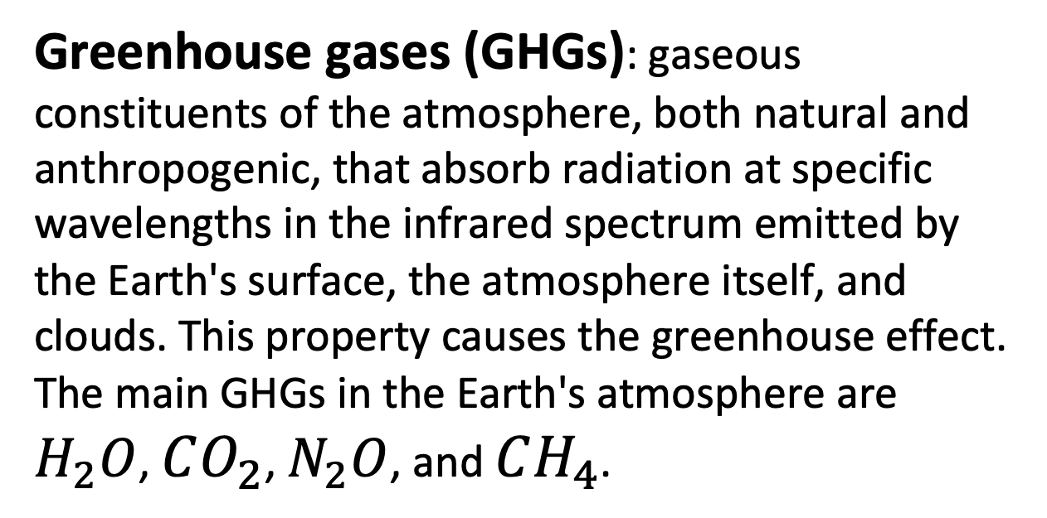
GLOSSARY / CULTIVATED LAND
1 Gt = 1 billion tonnes
= 10⁹ tonnes
1 Gt C = 1 Pg C
1 Mt = 10⁶ tonnes
1 Gt C = 3.666 Gt CO₂
IPCC: Intergovernmental Panel on Climate Change
Net primary production (NPP): a fundamental characteristic of an ecosystem, expressing the conversion of carbon dioxide into biomass through photosynthesis, after accounting for plant respiration (Gross Primary Production (GPP) – Plant Respiration).
Soil organic carbon (SOC): carbon included in the organic matter of the soil (soil organic matter is generally considered to be 50–60% C). Crucial for soil health, fertility, and other ecosystem services, including food production. (FAO).
Soil organic matter (SOM): any material initially produced by living organisms (plants or animals) that returns to the soil and undergoes the decomposition process. At any given time, it consists of a range of materials, from original, intact plant and animal tissues to a mixture of substantially decomposed matter.
(FAO).
Soil heterotrophic respiration: results from the mineralization of organic matter, primarily by microfauna, during which organic compounds are oxidized into carbon dioxide. This parameter is used to quantify microbial activity in soils.
Litter: any non-living biomass with a diameter smaller than the minimum diameter for dead wood (e.g., 10 cm) present on the surface or within the soil profile in various stages of decomposition. (FAO).
Crop rotation: organization of the sequential planting of species on a plot. (dicoagroecologie).
Residence time (RT): the duration for which a compound or substance, once introduced into the environment, remains before being physically removed or biologically or chemically transformed. (FAO).
Greenhouse gases (GHGs): gaseous constituents of the atmosphere, both natural and anthropogenic, that absorb radiation at specific wavelengths in the infrared spectrum emitted by the Earth's surface, the atmosphere itself, and clouds. This property causes the greenhouse effect. The main GHGs in the Earth's atmosphere are $H_{2}O$, $CO_{2}$, $N_{2}O$, and $CH_{4}$.

Slide 4
ECOSYSTEM OVERVIEW: DEFINITIONS AND KEY FIGURES

Slide 5
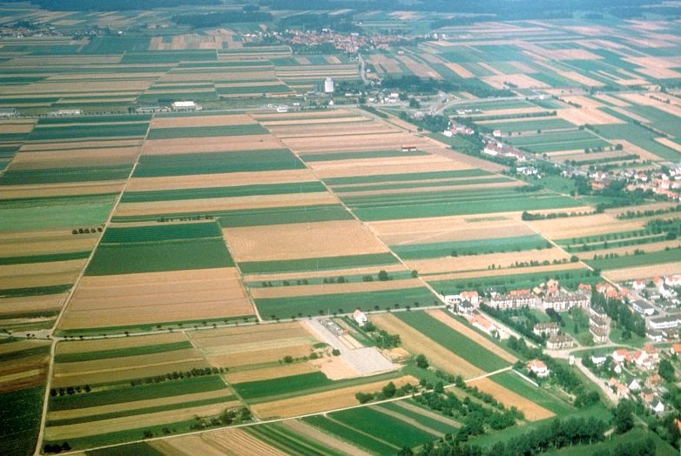
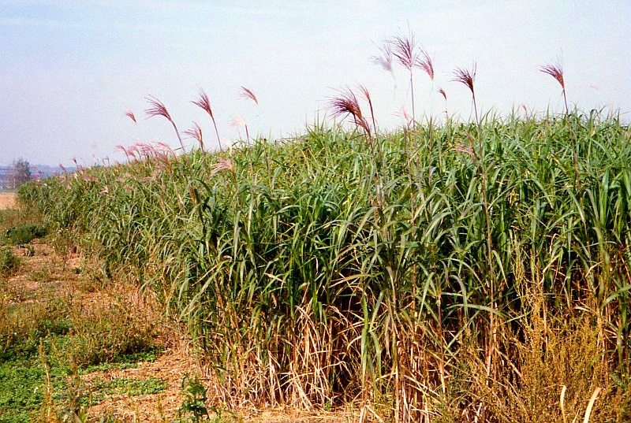
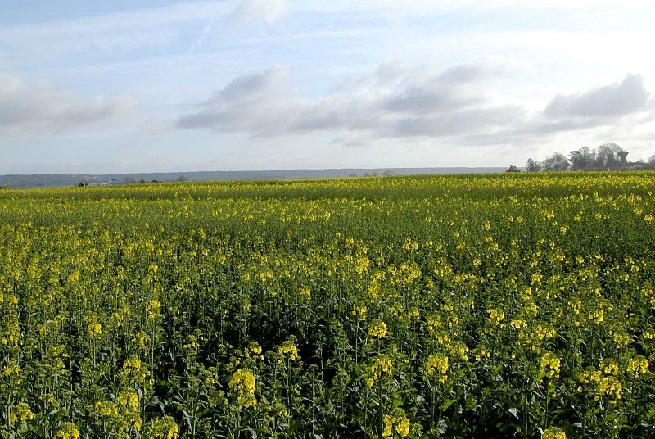
Definition of cultivated land according to the FAO
  Cultivated land = Arable land + Land under permanent crops
Arable land
Land under temporary crops, temporary meadows for mowing or pasture, land under market and kitchen gardens, and land temporarily fallow (less than five years). Land abandoned due to shifting cultivation is not included in this category. The data for arable land are not intended to indicate the amount of land that is potentially cultivable.
Land under permanent crops
Land dedicated to crops that remain for long periods and do not require replanting after each harvest, such as cocoa, coffee, and rubber; this category includes land under hedgerow shrubs, fruit trees, nut trees, and vines, but excludes land planted with trees grown for firewood and timber.
Polyculture landscape
© INRAE / BOUCHERY Yves
Miscanthus field
© INRAE / CHARTIER Michel
Rapeseed field
© INRAE / SAVIN Alexandre

Slide 6
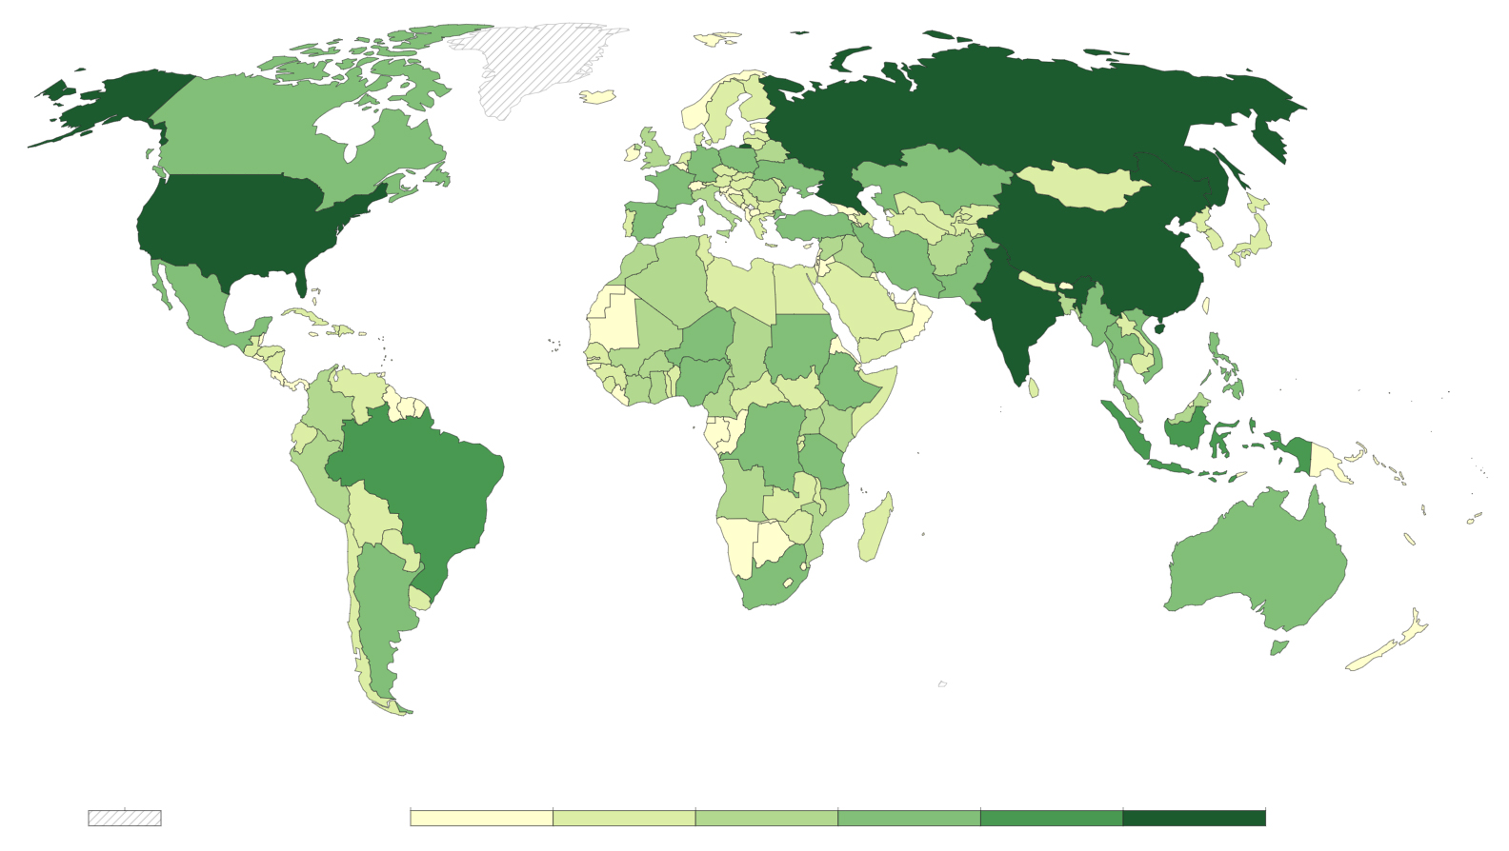
Cultivated land worldwide
Global area (land use)
Agriculture: 4 818 million ha
Cultivated land: 1 580 million ha
Temporary meadows: 144 million ha
Global production of major crops (dry matter)
  1er Sugar cane: 1 900 Mt.year⁻¹
  2e Maize (corn): 1 200 Mt.year⁻¹
  3e Rice: 787 Mt.year⁻¹
  4e Wheat: 771 Mt.year⁻¹
  5e Oil palm fruits: 416 Mt.year⁻¹
No data
0 1 5 10 50 100 500 million ha
Cultivated land areas by country (FAO, 2020)
!
This map does not indicate the percentage of cultivated land by territory: a larger country will tend to have more cultivated land than a smaller country, even if the latter is more densely cultivated.
(FAOSTAT, 2021)

Slide 7
STOCKS AND FORMS OF ORGANIC CARBON

Slide 8
Soil organic carbon stocks of cultivated land
 | Worldwide | In France
Cultivated land area | 1.60 x 10⁹ ha | 18.4 x 10⁶ ha
Carbon stock per unit area | 81 t C.ha⁻¹ _{(0 - 1 m)} | 51.6 ± 16.2 t C.ha⁻¹ _{(0 - 30 cm)}
Total carbon stock | 131 Gt C _{(0 - 1 m)} | 950 Mt C _{(0 - 30 cm)}
Data source | IPCC SRES Land-Use 1998 | RMQS - GIS Sol 2020
There is a high variability around the average values indicated.
When compared at the same depth, the SOC stocks in French cultivated soils are similar to the global average.
In continental France and Corsica, cultivated soils cover about 45% of the land area and represent about 30% of the soil carbon stocks.
(Jobbagy & Jackson, 2000)
8

Slide 9
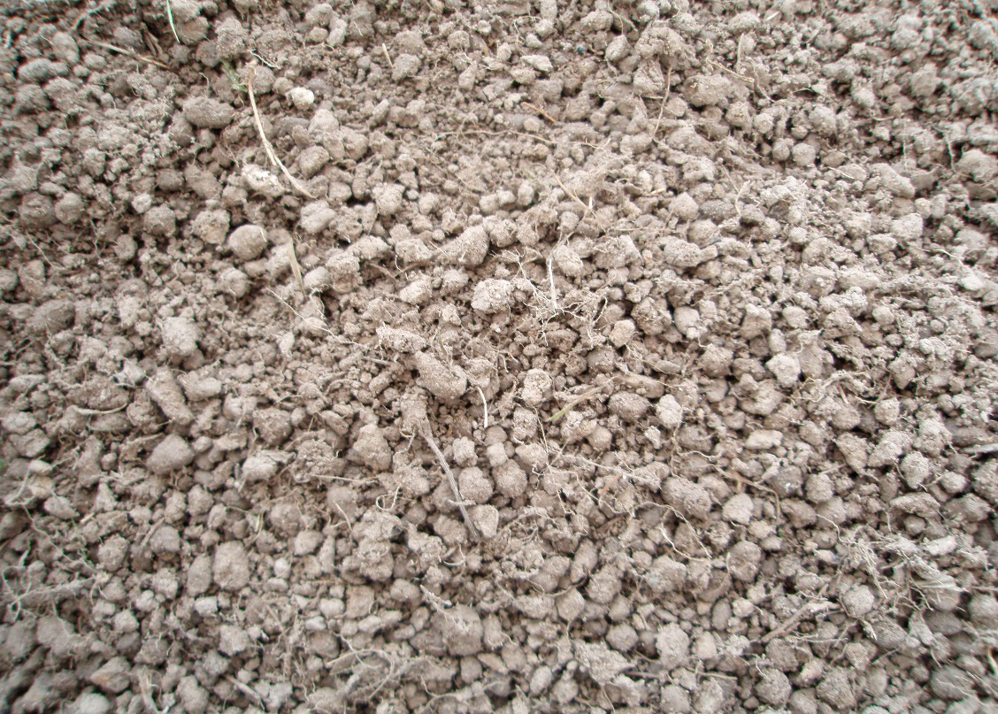
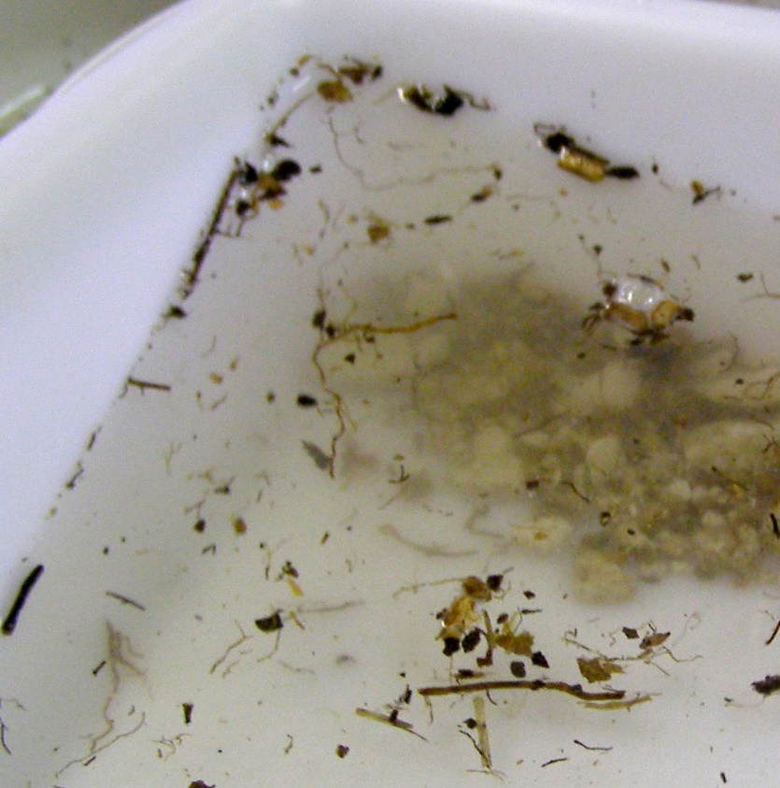
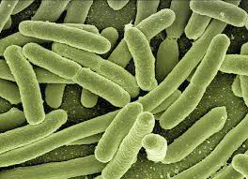
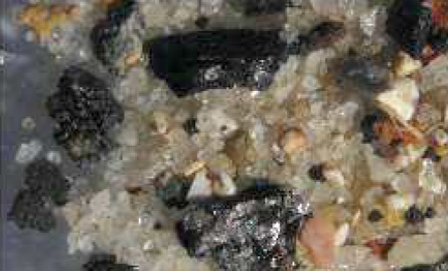
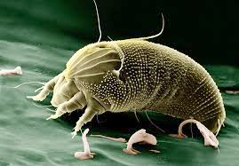
Different forms of organic carbon in soils
Organic molecules of plant or microbial origin associated with minerals, giving a dark color.
about 60–95%
Decomposing plant debris (floating in water due to its density).
about 5–30%
© DURAND Hermine
© DURAND Hermine
Pyrogenic organic matter.
about 5–30%
Living organic matter.
about 1–5%
© CHASSÉ Matthieu
+
Dissolved organic carbon.
< 1 %
Atlas européen de la biodiversité des sols (2013)

Slide 10
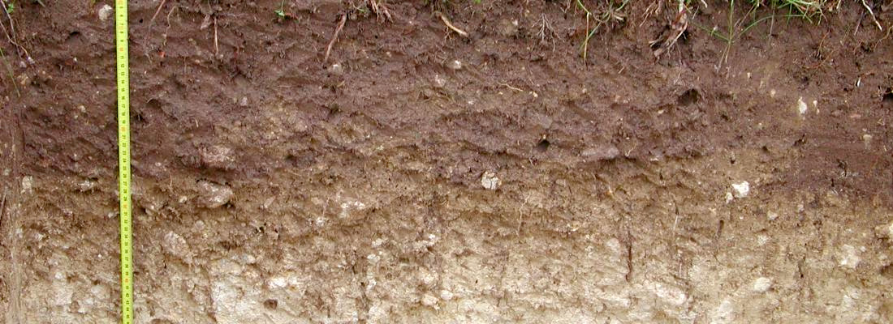
Vertical distribution of organic carbon in cultivated soils
Profile of organic carbon distribution in cultivated soils
© INRAE / JOLIVET Claudy
More carbon on the surface, but there is some at depth as well!
In brown, relative carbon stock in the 0–1 m layer; in gray, additional stock relative to the amount measured between 0 and 1 m.
About 2/3 of the organic carbon is in the first meter, and 25–30% is in the 0–20 cm layer.
(Jobbagy & Jackson, 2000)

Slide 11
ORGANIC CARBON DYNAMICS

Slide 12
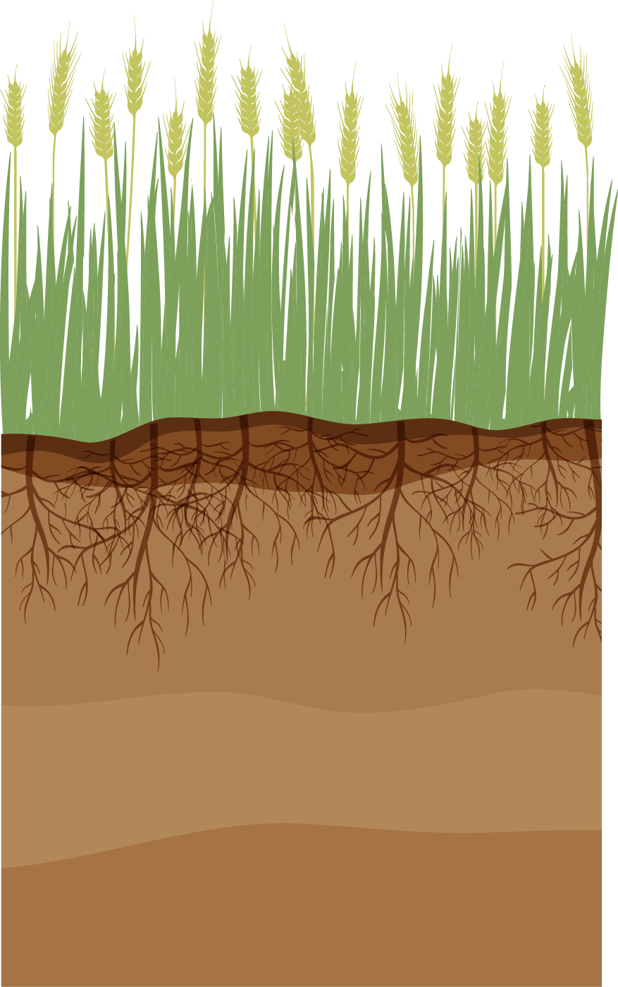
General diagram of carbon dynamics in cultivated ecosystems
C INPUTS
Aboveground and belowground litter
Organic amendments
Influenced by:
Net Primary Production (NPP), strongly dependent on climate
Crop rotations (choice of crops, temporary grasslands, etc.)
Practices (e.g., straw return, cover crops, amendment applications)
CO₂

Slide 13




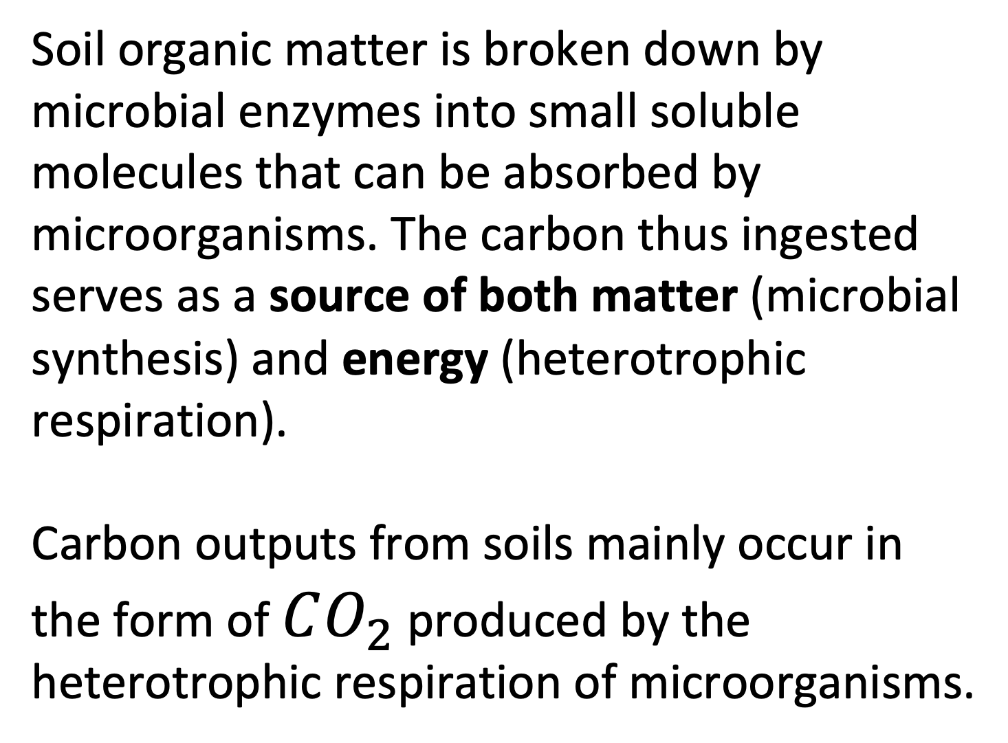
General diagram of carbon dynamics in cultivated ecosystems
C INPUTS
Aboveground and belowground litter
Organic amendments
Influenced by:
Net Primary Production (NPP), strongly dependent on climate
Crop rotations (choice of crops, temporary grasslands, etc.)
Practices (e.g., straw return, cover crops, amendment applications)
CO₂
CO₂
C OUTPUTS
Respiration, mainly by microorganisms (dependent on pedoclimatic conditions)
Erosion and leaching
Soil organic matter is broken down by microbial enzymes into small soluble molecules that can be absorbed by microorganisms. The carbon thus ingested serves as a source of both matter (microbial synthesis) and energy (heterotrophic respiration).
Carbon outputs from soils mainly occur in the form of $CO_{2}$ produced by the heterotrophic respiration of microorganisms.
Biotransformations
(microbial synthesis, depolymerization, fragmentation)
Transfers
(bioturbation, diffusion, etc.)

Slide 14
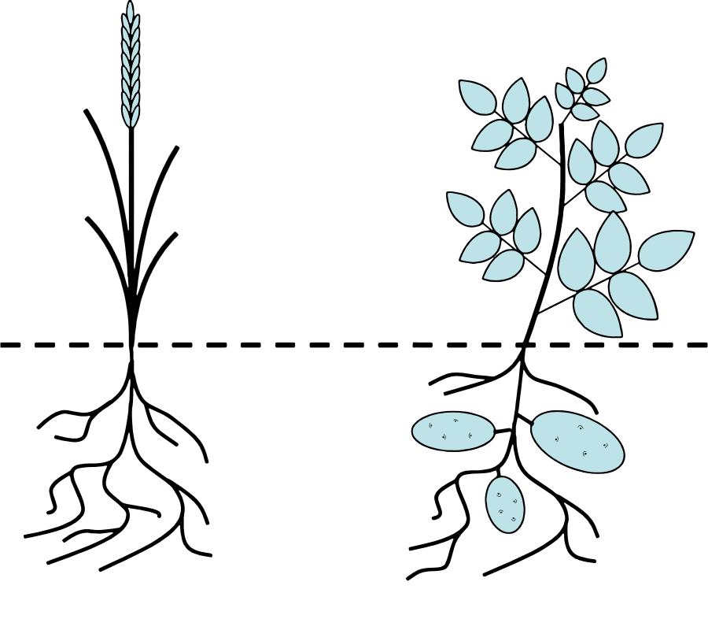
Estimation of carbon inputs in cultivated lands
according to Bolinder et al., 2007
C_{P}
C_{P}: Carbon in the harvested part of the plant
C_{S}: Carbon in the residues (non-harvested) of aboveground biomass
C_{R}: Carbon in non-harvested root tissues
C_{E}: Carbon in root exudates (rhizodeposition)
C_{s}
C_{R}
Root and exudate carbon (C_{R} and C_{E}) has a longer residence time than aboveground carbon (C_{S} and C_{P}).
Root-derived C
C_{E}
Root-derived C
(Rasse et al., 2006)
Illustration of the different carbon pools for two conceptualized plants.

Slide 15
Estimation of carbon inputs in cultivated lands
The estimation of RC (root carbon) is based on the shoot-to-root ratio, denoted as S:R (ratio of aboveground to root biomass).
Average shoot-to-root ratio values in croplands:
S:R ∼5 ± 3 for annual crops (maize, soybean)
S:R ∼1–2 for forage crops (grasses, legumes)
according to Bolinder et al., 2007
Max input:
424 g C m⁻² year⁻¹
Aboveground
Min input:
142 g C m⁻² year⁻¹
Aboveground
Total potential carbon inputs (g m⁻² yr⁻¹)
Aboveground
∆ = 283
Belowground
Belowground
Belowground
The estimation of carbon inputs into the soil depends on the shoot-to-root ratio.
Uncertainty associated with annual below-ground carbon inputs (C_{R} and C_{E}) for a medium-yield grain corn crop (9 Mg grain ha⁻¹), across different values of shoot-to-root ratio.

Slide 16
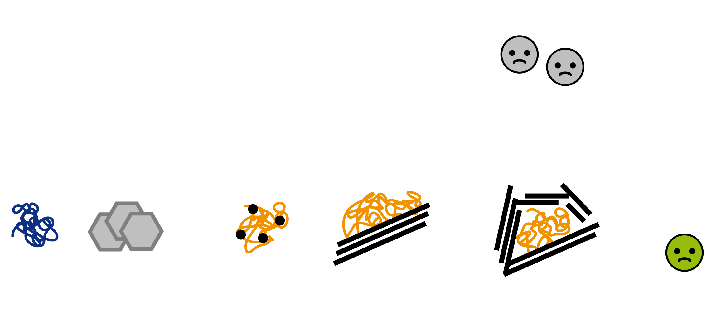
Mechanisms of Organic Matter Stabilization in Soils
Selective Preservation
Recalcitrance
Interaction with Ions or Mineral Surfaces
Physical Protection
Environmental Conditions for Microorganisms
Macro-molecules
Pyrogenic Carbon
Complexation
Adsorption
Inaccessibility, Local Physical Conditions
The rate at which organic matter can be degraded depends on its chemical composition, its interaction with the mineral phase, its accessibility to microorganisms, and environmental conditions.
according to Chenu et al., 2009, CMS series

Slide 17
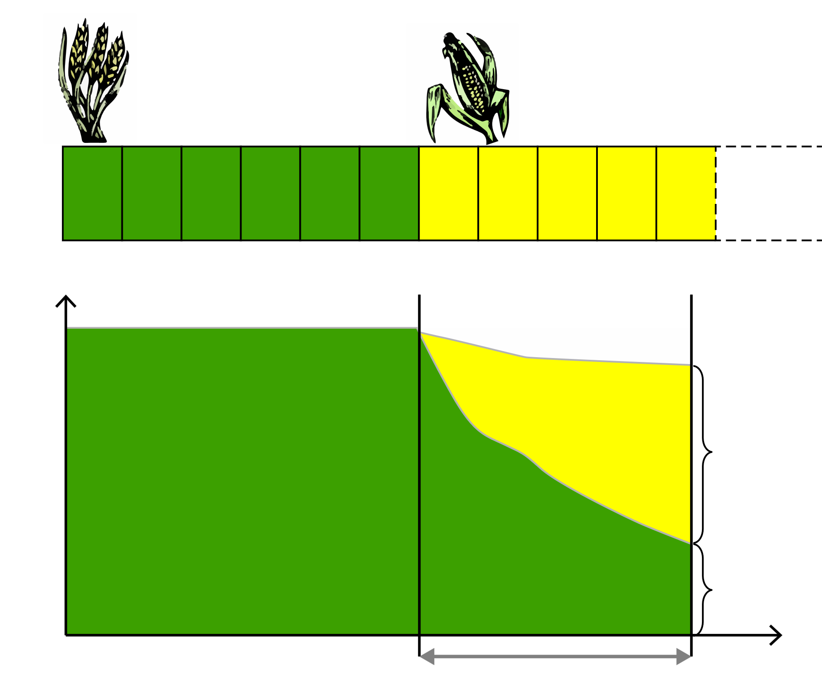
Measurement of the Biogeochemical Stability of Soil Organic Carbon
– Isotopic Method –
C3
C4
The organic matter from C3-type photosynthetic plants (e.g., wheat) and C4-type plants (e.g., maize) does not have the same isotopic signature.
Growing C4 plants on soils that previously only supported C3 plants makes it possible to track over time the amount of carbon derived from C3 plants, thereby observing its biogeochemical stability.
δ¹³C_{B} = - 28 ‰
δ¹³C_{M} = - 12 ‰
Wheat
Maize
C_{M}
Soil carbon
δ¹³C_{O}
Studies using isotopic tools show that the SOC (Soil Organic Carbon) in cultivated soils has an average residence time of several decades, and that 40–60% of SOC persists for more than 100 years.
C_{B}
0
~ 100 years
t
Time
C3/C4 Chronosequence
adapted from Balesdent, 1991.
(e.g. Balesdent et al., 1988)

Slide 18
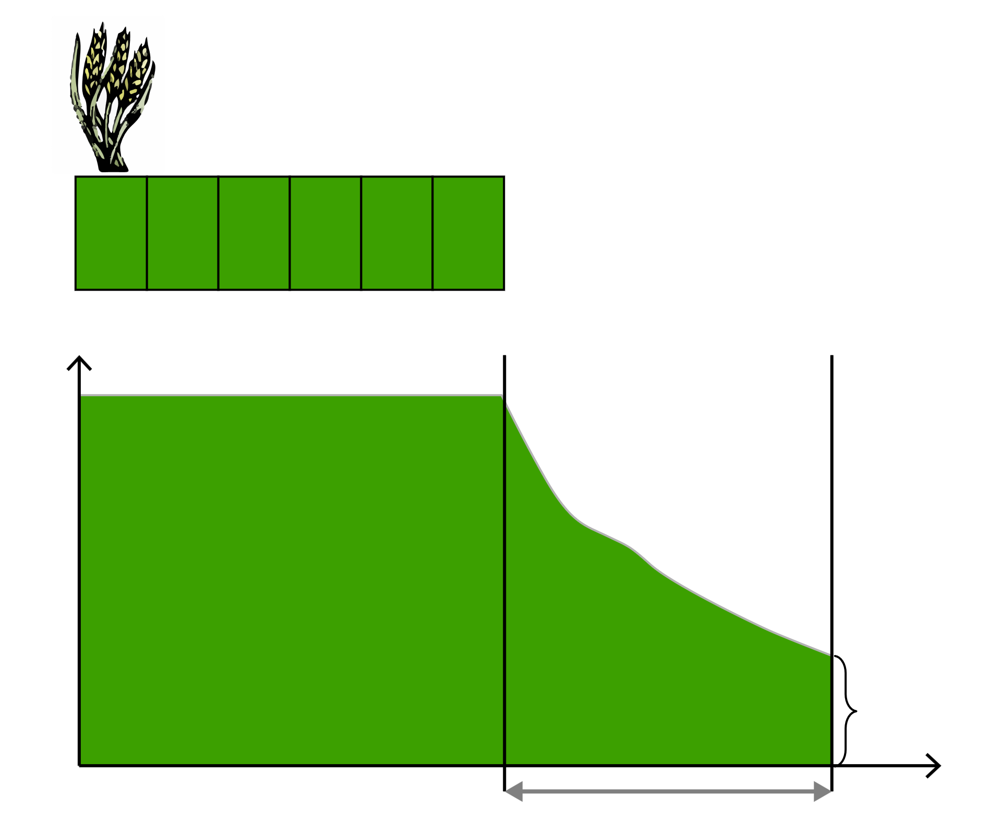
Measurement of the Biogeochemical Stability of Soil Organic Carbon
– Bare Fallow –
C3
The bare fallow method involves maintaining the soil without vegetation, resulting in negligible carbon inputs.
Microorganisms continue to degrade organic matter, explaining the decline in organic carbon.
Monitoring carbon stocks/contents in bare fallow soils provides a measure of biogeochemical stability.
δ¹³C_{B} = - 28 ‰
Wheat
Soil carbon
δ¹³C_{O}
Observations from various bare fallow sites confirm the results obtained using the isotopic approach.
C_{B}
0
~ 100 years
t
Time
Long-term bare fallow
adapted from Balesdent, 1991.
(Barré et al., 2010)

Slide 19
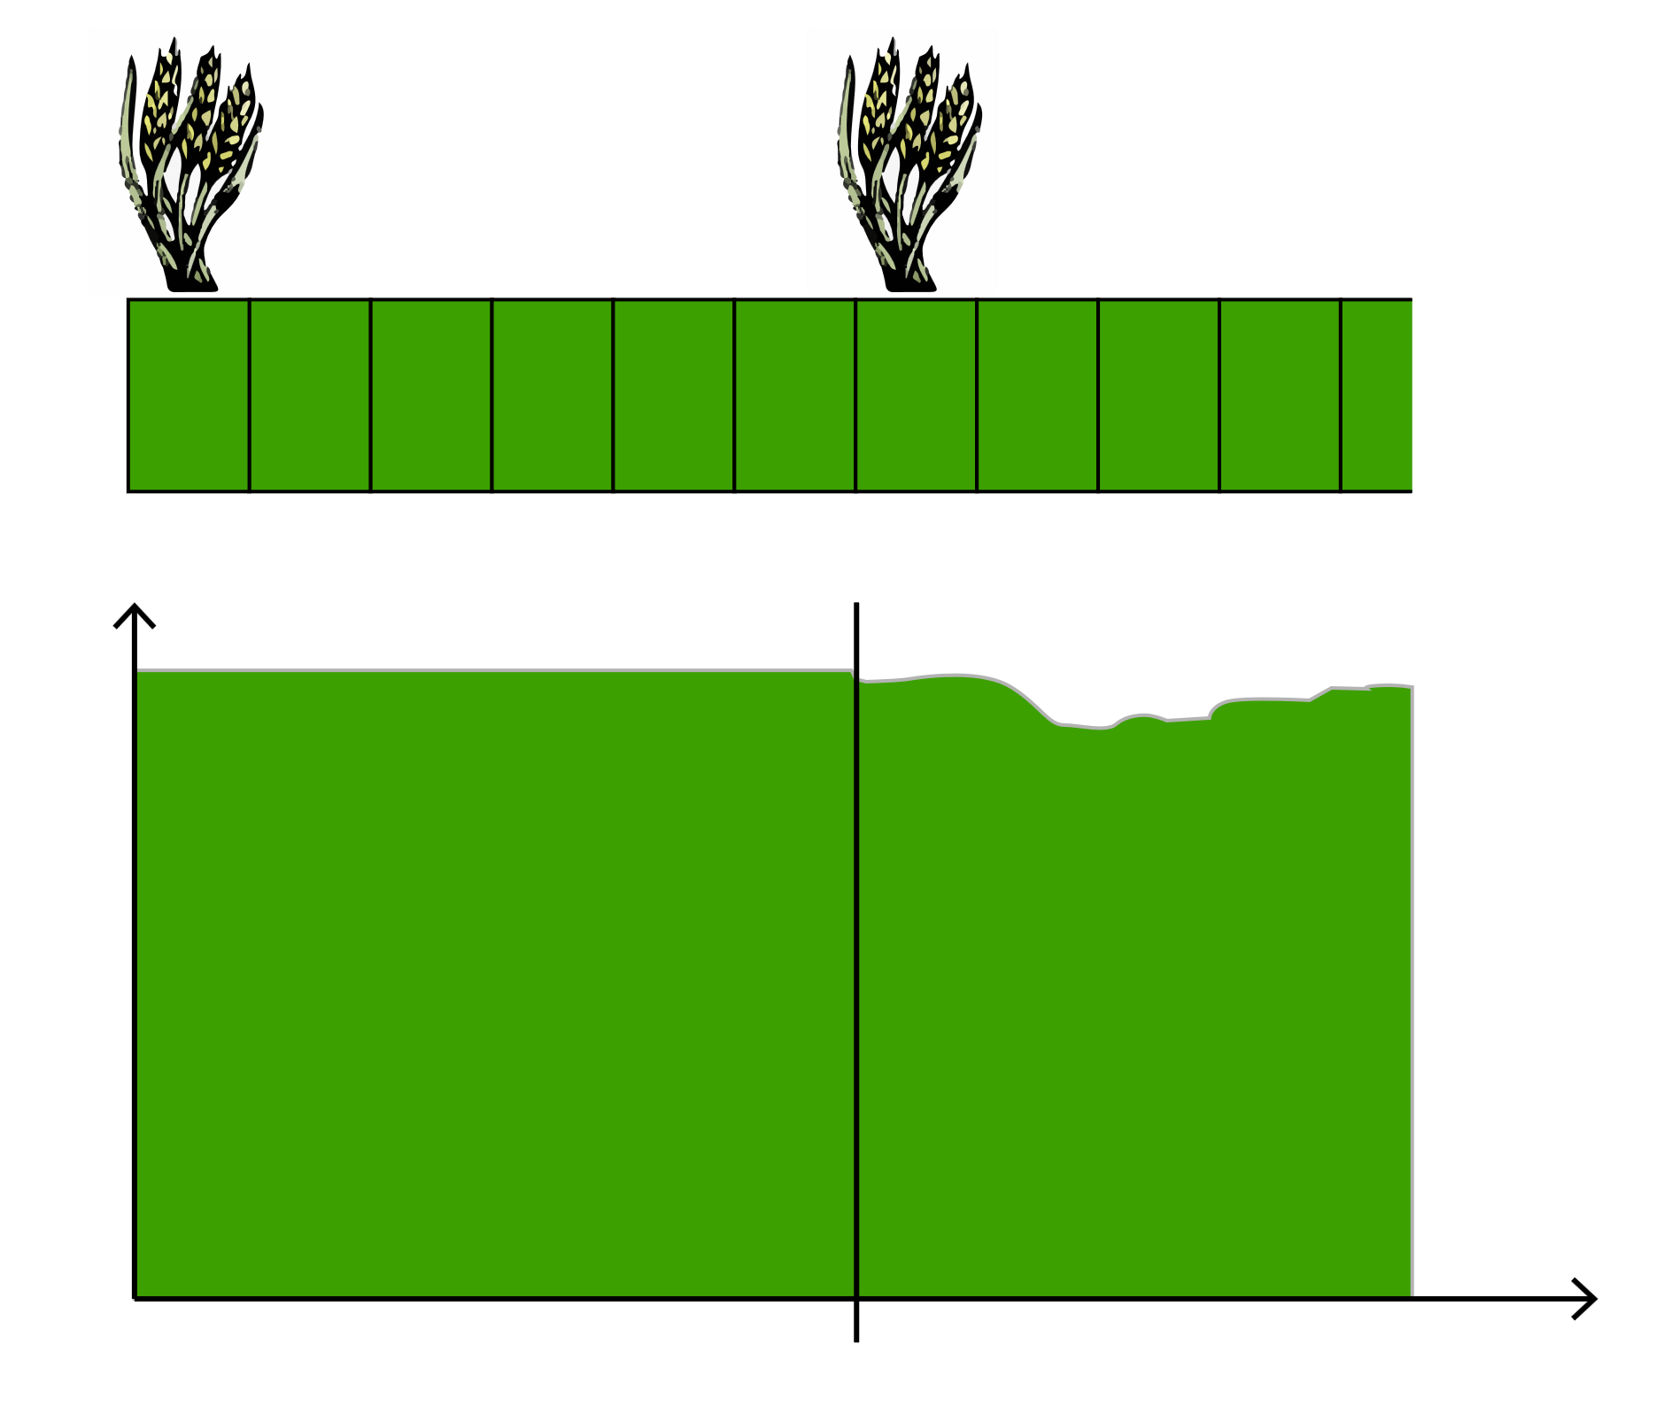
Measurement of the Biogeochemical Stability of Soil Organic Carbon
– Contribution of Modeling –
C3
C3
Numerous models are available to simulate changes in soil carbon stocks.
The simulation of stock evolution between time t and t+1 involves adding carbon inputs over that time interval and subtracting outputs (microbial respiration).
When the stock changes and carbon inputs are known (as is the case in long-term agronomic experiments), it is possible to determine biogeochemical stability through the differences observed.
δ¹³C_{B} = - 28 ‰
δ¹³C_{B} = - 28 ‰
Wheat
Wheat
Soil carbon
δ¹³C_{O}
This kind of approach shows that different models require a stable (residence time of several centuries) or inert compartment representing 20–75% of soil organic carbon.
0
t
Time
Simulations of SOC stock evolution in long-term agronomic trials (with known carbon inputs)
adapted from Balesdent, 1991.
(e.g. Clivot et al., 2019)

Slide 20


Synthesis of the Multi-Approach Assessment of the Biogeochemical Stability of Soil Organic Carbon (SOC)
C3
C4
C3
C3
C3
δ¹³C_{B} = - 28 ‰
δ¹³C_{M} = - 12 ‰
δ¹³C_{B} = - 28 ‰
δ¹³C_{B} = - 28 ‰
δ¹³C_{B} = - 28 ‰
Wheat
Maize
Wheat
Wheat
Wheat
C_{M}
δ¹³C_{O}
δ¹³C_{O}
δ¹³C_{O}
Soil carbon
C_{B}
Soil carbon
C_{B}
Soil carbon
0
t
Time
0
t
Time
0
t
Time
C3/C4 chronosequence
Long-term bare fallow
Simulations of SOC stock evolution in long-term agronomic trials
In the upper 0–30 cm layer:
1–5% of organic carbon has a short mean residence time (years).
25–70% of organic carbon has a mean residence time on the order of several decades.
30–75% has a mean residence time exceeding a century.
Residence time increases with depth.
(Balesdent et al., 2018)

Slide 21
LEVERS FOR CARBON STORAGE

Slide 22
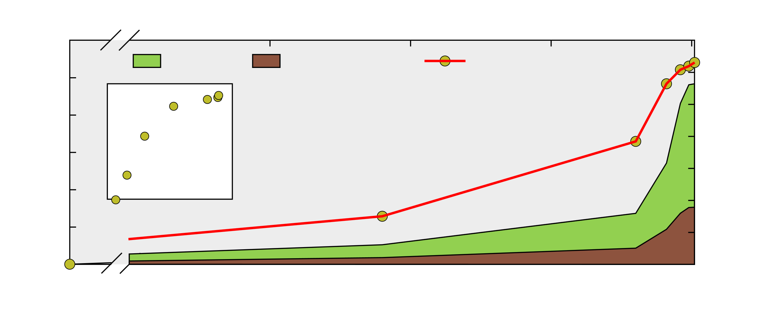
Soil Cultivation Leads to Carbon Loss
according to Sanderman et al., 2017
60
140
Pastures
Cultivated Land
Soil Carbon Loss
120
50
40
100
Land Area Used
(10⁶ km²)
80
Soil Carbon Loss
Cumulative Soil Carbon Loss (Gt C)
30
60
20
40
10
Land Area Used
20
0
0
0
500
1000
1500
2000
Year
  Models show that cultivation has likely caused a total loss of 133 Gt C globally from the top two meters of soil since the beginning of agriculture.
  Today, at the global scale, agricultural land use and land-use change related to agricultural activities release approximately 1 Gt C per year. (FAOSTAT 2020).

Slide 23
Soil Cultivation Leads to Carbon Loss
according to Sanderman et al., 2017
60
140
Pastures
Cultivated Land
Soil Carbon Loss
120
50
40
100
Land Area Used
(10⁶ km²)
80
Soil Carbon Loss
Cumulative Soil Carbon Loss (Gt C)
30
60
20
40
10
Land Area Used
20
0
0
0
500
1000
1500
2000
Year
The challenge is therefore to restore part of this lost carbon in cultivated soils and to prevent further losses!

Slide 24
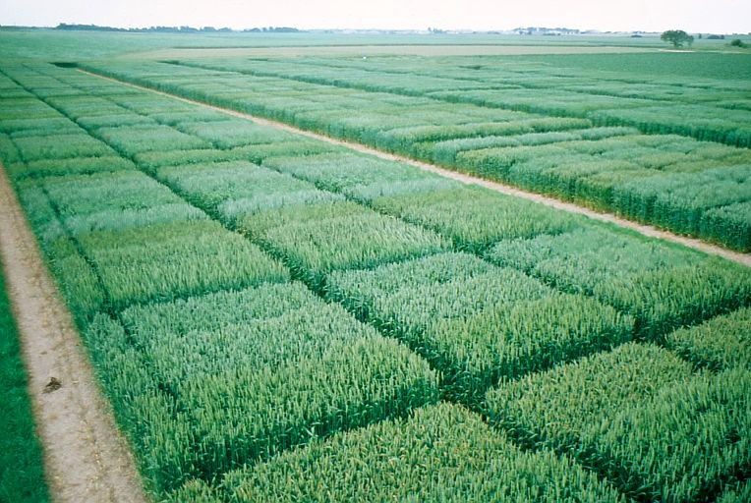
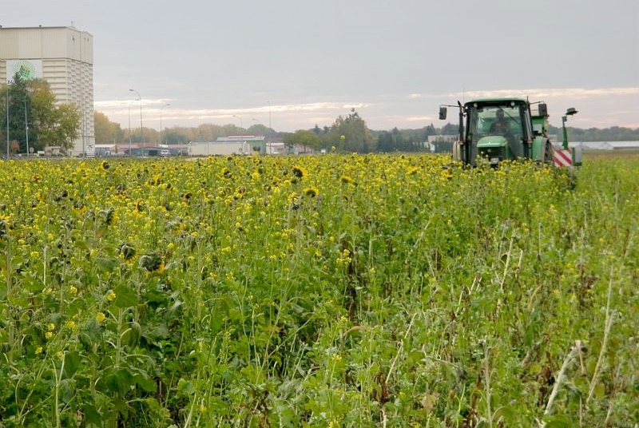
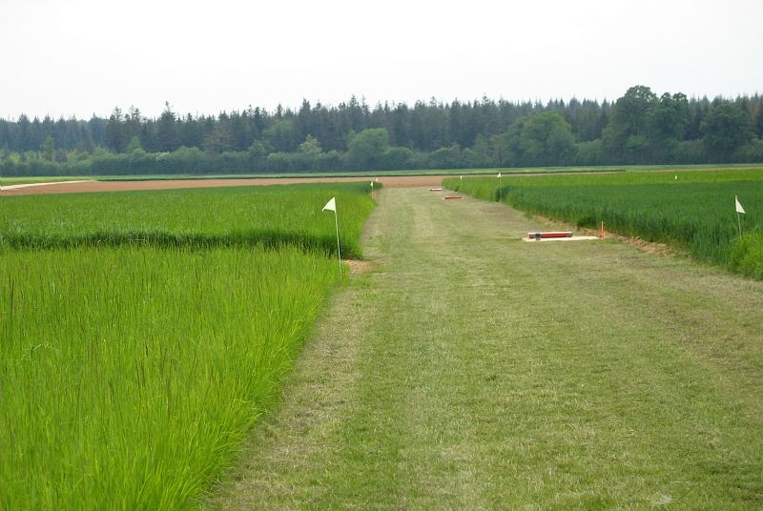
Increasing Inputs or Reducing Carbon Losses to Maintain or Enhance Soil Carbon Stocks in Cultivated Soils
1
By increasing soil cover through the introduction of cover crops.
2
By reducing tillage (note: this practice may lead to increased herbicide use, which poses challenges for biodiversity, water quality, and human health).
3
By increasing the proportion of temporary grasslands in crop rotations.
© INRAE / FOUCHARD Marc
© INRAE / FARCY Pascal
© INRAE / CHEVET Karine

Slide 25
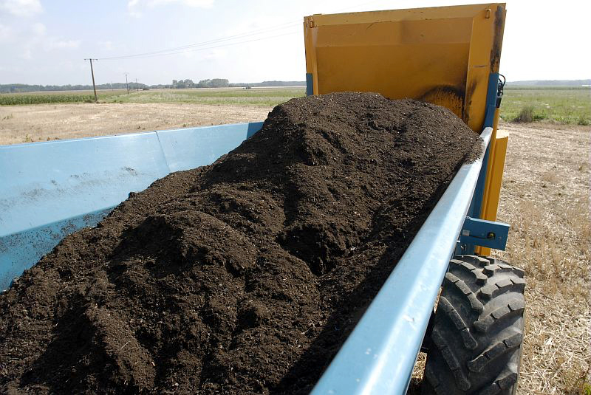
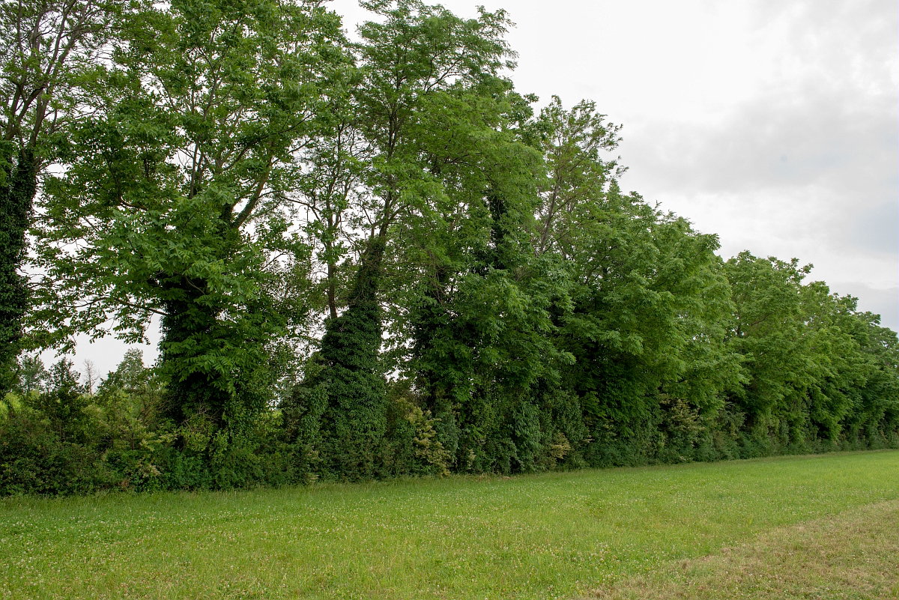
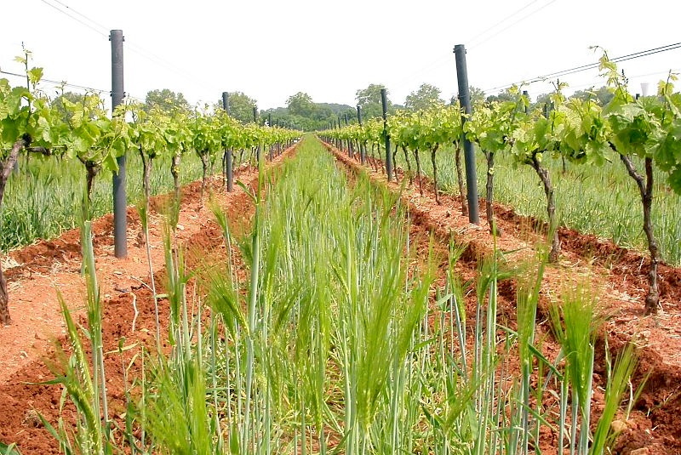
Increasing Inputs or Reducing Carbon Losses to Maintain or Enhance Soil Carbon Stocks in Cultivated Soils
4
By applying organic matter to soils in the form of amendments.
5
By developing hedgerows and agroforestry within cultivated fields.
6
By planting grass cover between rows in vineyards and orchards.
© INRAE / MAITRE Christophe
© INRAE / NICOLAS Bertrand
© INRAE / BOUISSON Yvan
Globally, 1.2 Gt of carbon per year could be stored in agricultural soils (croplands and grasslands) (IPCC 2014), which would offset more than 10% of annual anthropogenic emissions.

Slide 26
How much carbon could be stored in cultivated soils in continental France in the coming decades?
Additional Storage by Practice | Additional Storage per Hectare 0–30 cm horizon (kg C/ha/year) | Area (M ha) | Additional Storage All of France 0–30 cm horizon (Mt C/year) | Additional Storage Relative to the Stock of the Corresponding Land Use (‰/year)
(Study 4 per 1000 INRAE, 2019)
In arable crops and temporary grasslands
Extension of intermediate crops | +126 | 16.03 | +2.019
Direct seeding | +60 | 11.29 | +0.677
New organic resources | +61 | 4.21 | +0.257
Insertion and extension of temporary grasslands | +114 | 6.63 | +0.756
Intra-field agroforestry | +207 | 5.33 | +1.102
Hedgerows | +17 | 8.83 | +0.150
Total field crops |  |  | +4.960 (86%) | +5.2
In vineyards
Grass cover | +182 | 0.56 | +0.103
Total vineyards |  |  | +0.100 (2%) | +3.7
At the scale of mainland France and Corsica, increasing carbon stocks in cultivated soils could offset about 5% of emissions.
(Study 4 per 1000 INRAE, 2020)

Slide 27
Carbon Storage in Agricultural Soils Is Not
Just a Biophysical Issue!
Technical Carbon Storage Potential: The level of additional storage achievable (taking into account biophysical limits) by implementing all technically feasible actions on the cultivated land of a territory.
Technical
Potential
The difference between carbon storage that is technically feasible and carbon storage that is socio-politically feasible.
  Economic Limits: The implementation of carbon-storing practices usually incurs additional costs. If these costs are prohibitive or if no support is provided for implementing these practices, the economic potential for storage may be very different from the technical potential.
Economic
Limit
Maximum carbon sequestration potential
Socio-political
Limit
  Social Limits: Even with adequate economic support, the implementation of carbon-storing practices may encounter resistance from farmers.
0
(Inspired by Amundson & Biardeau PNAS 2018)

Slide 28
Climate Benefits of Increasing Carbon Stocks in Cultivated Soils: An Integrated and Systemic Assessment
Beyond CO₂ fluxes, N₂O fluxes (and sometimes CH₄) have a significant impact on the greenhouse gas (GHG) balance of cultivated land. To assess the climate benefit, it is necessary to carry out a full GHG balance of the plot. This balance is expressed in “CO₂ equivalent.” The concentration in carbon dioxide equivalent is the concentration of CO₂ that would cause the same radiative forcing as a given mixture of CO₂ and other forcing agents.
Definitions (according to Don et al., 2023)
Soil Organic Carbon (SOC) sequestration: Net carbon flux from the atmosphere into the soil. This process occurs through plants or other organisms. It is more commonly referred to as carbon storage.
Negative emissions: Net reduction of CO₂-equivalent greenhouse gases in the atmosphere (GHG removal).
Climate change mitigation: Anthropogenic intervention that reduces sources or enhances sinks of greenhouse gases.
Agriculture accounts for 10 to 12% of anthropogenic GHG emissions (5.1 to 6.1 Gt CO₂ eq/year), mainly due to CH₄ and N₂O emissions.
(IPCC, 2007)

Slide 29
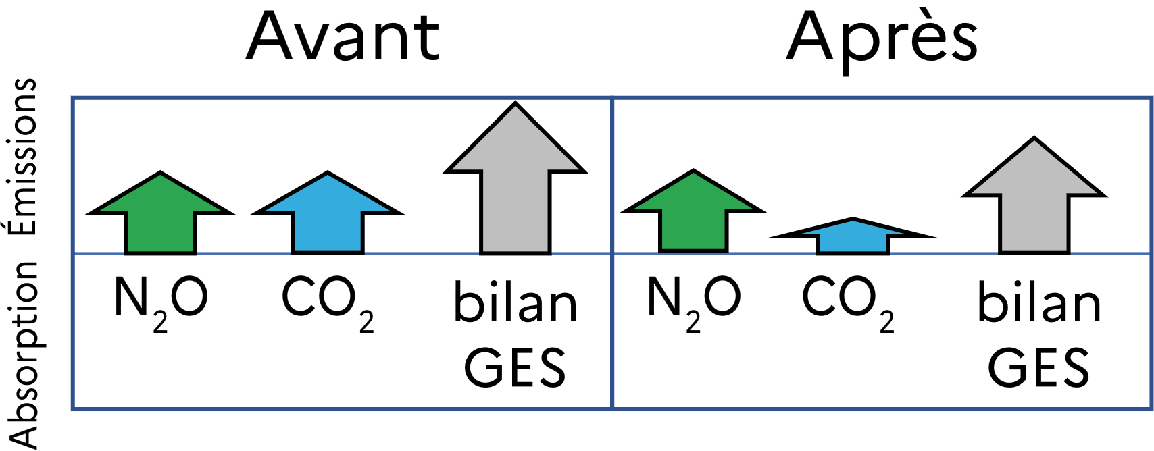
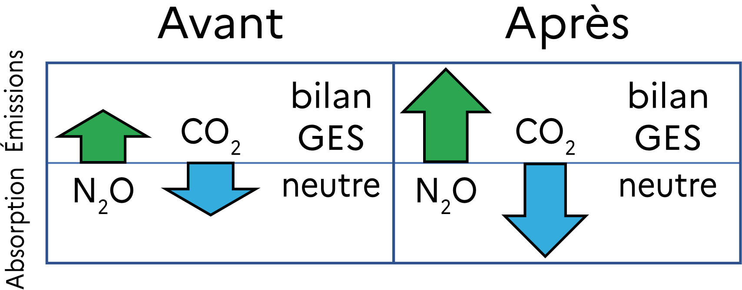
Climate Benefits of Increasing Carbon Stocks in Cultivated Soils: An Integrated and Systemic Assessment
!
Reduction of GHG emissions ≠ Negative emissions
In the example shown, the reduction in CO₂ emissions helps lower GHG emissions (and thus mitigates climate change), but this reduction is not sufficient to achieve negative emissions (i.e., shifting from a situation of emission to one of absorption).
Before
After
Emissions
Uptake
GHG
balance
GHG
balance
!
(according to Don et al., 2023)
Increasing carbon stocks ≠ Mitigating climate change
For example, if an increase in Soil Organic Carbon (SOC) stocks requires a significant rise in nitrogen fertilizer inputs, this leads to higher N₂O emissions: the GHG balance remains unchanged, despite the effort to sequester carbon in soils.
Before
After
Emissions
neutral
neutral
Uptake
GHG
balance
GHG
balance
(according to Don et al., 2023)

Slide 30
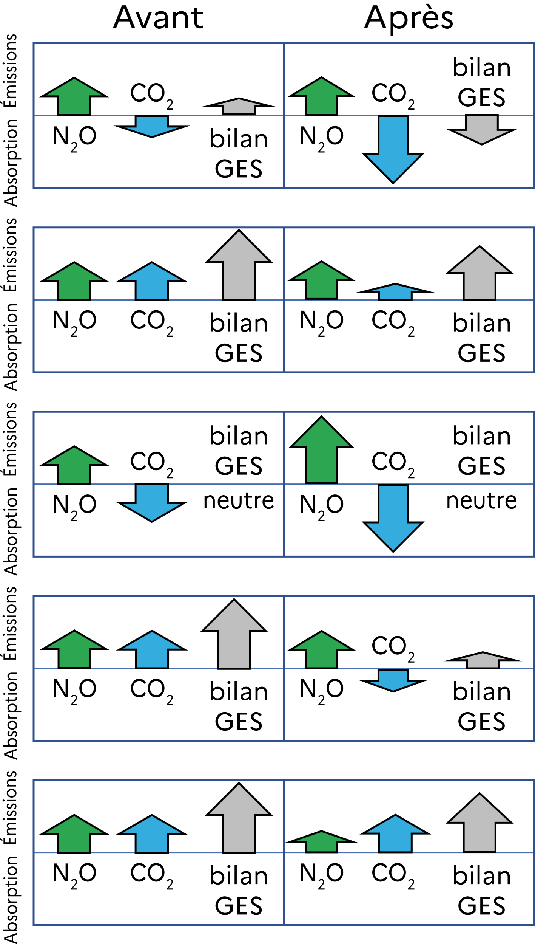
Theoretical Examples of Site-Specific Impacts of Practice Changes on Soil and Atmospheric Carbon Pools and N₂O Fluxes
Cropland management change… |  | SOC loss mitigation | Climate change mitigation | C sequestration | Negative emissions | Reduction in GHG emissions
… to more cover crops |  | - | OUI | OUI | OUI | OUI
… to more cover crops at sites with SOC loss |  | OUI | OUI | NON | NON | OUI
… to increased fertilization |  | - | NON | OUI | NON | NON
… to genotypes with increased root biomass |  | OUI | OUI | OUI | NON | OUI
… to reduced fertilization at sites with SOC loss |  | NON | OUI | NON | NON | OUI
Before
After
Emissions
GHG
balance
GHG
balance
YES
YES
YES
YES
Uptake
Uptake
Emissions
YES
YES
NO
NO
YES
GHG
balance
GHG
balance
Emissions
neutral
neutral
NO
YES
NO
NO
Uptake
GHG
balance
GHG
balance
Emissions
YES
YES
YES
NO
YES
Uptake
GHG
balance
GHG
balance
(Adapted from Don et al., 2023)
Emissions
GHG
balance
GHG
balance
NO
YES
NO
NO
YES
Uptake

Slide 31
Climate Benefits of Increasing Carbon Stocks in Cultivated Soils: An Integrated and Systemic Assessment
!
Reduction of GHG Emissions ≠ Negative Emissions
!
Increasing Carbon Stocks ≠ Mitigating Climate Change
!
GHG emissions associated with the production and application of fertilizers are not accounted for in the graphs above.
(Don et al., 2023)
!
The graphs above do not consider the systemic land-use consequences of production changes on a given plot (e.g., a decrease in food production in one area could be offset elsewhere by the conversion of natural ecosystems into cultivated land).

Slide 32
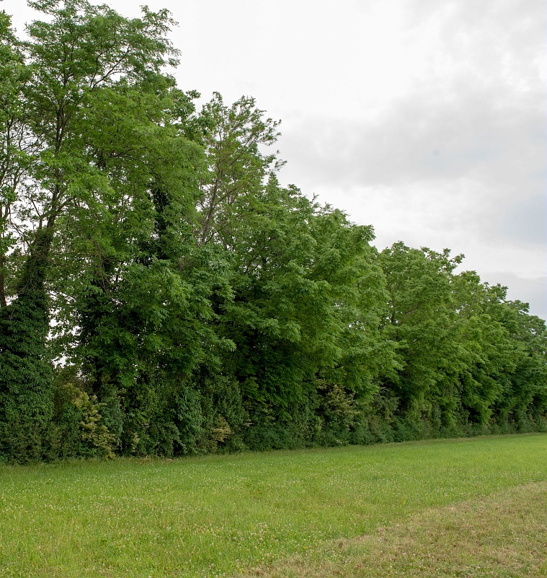
Some practices provide co-benefits associated with the protection or increase of organic carbon stocks in the ecosystem
Cover crops:
In-field agroforestry and hedgerows have a positive impact on:
Improve water quality (nitrate trapping);
Limit erosion;
Contribute to climate change mitigation through biophysical effects (e.g., albedo effects).
Biodiversity;
Landscape aesthetics;
Reduction of erosion risk related to surface runoff.
© INRAE / NICOLAS Bertrand
© INRAE / NICOLAS Bertrand
© INRAE / FOUCHARD Marc

Slide 33
Conclusions

Slide 34
Key Points to Remember
13C/12C
13C/12C
Cultivated lands represent one-third of agricultural areas and store more than 130 Gt of carbon.
In the cultivated land ecosystem, over 95% of the carbon is stored in the soil, with only 5% stored in biomass.
The residence time of carbon in cultivated lands can be measured using various approaches, including C3/C4 chronosequences.
Carbon content in cultivated soils
Carbon inputs come from litter and organic amendments; carbon outputs are primarily due to microbial respiration, and to a lesser extent erosion and leaching.
Soil Organic Carbon (SOC) can be divided into kinetic pools with contrasting residence times (RT):
1–5% with RT of years;
25–70% with RT of several decades;
30–75% with RT of a few centuries.
TR
RT
decreases
with depth.

Slide 35


Key points to remember
Land-use change is a significant source of carbon emissions.
Increasing soil carbon stocks in cultivated lands does not always lead to climate change mitigation, as other greenhouse gases also factor into the overall balance.
There are techniques to preserve or increase existing carbon stocks: cover crops, temporary grasslands, no-till farming, hedgerows, agroforestry, grass cover, etc.

Slide 36
SOURCES / CULTIVATED LAND
Definition of cultivated land according to the FAO
https://www.fao.org/4/i0132e/i0132e08.pdf
https://www.fao.org/economic/the-statistics-division-ess/other-statistics/socio-economic-agricultural-and-environmental-indicators/compendium-of-agricultural-environmental-indicators-1989-91-to-2000/annex-2-definitions/en/
Cultivated land worldwide
https://www.fao.org/faostat/en/#data/QCL
https://www.fao.org/faostat/en/#data/RL
https://ourworldindata.org/grapher/cropland-area?time=latest
Soil organic carbon stocks of cultivated land
https://ourworldindata.org/grapher/cropland-area
https://archive.ipcc.ch/ipccreports/sres/land_use/index.php?idp=3
https://www.inrae.fr/sites/default/files/pdf/etude-4-pour-1000-resume-en-francais-pdf-1_0.pdf
Different forms of organic carbon in soils
https://www.inrae.fr/sites/default/files/pdf/4pM-Synth%C3%A8se-Novembre2020.pdf
Vertical distribution of organic carbon in cultivated soils
Jobbágy E.G. & Jackson R.B. (2000). The Vertical Distribution of Soil Organic Carbon and Its Relation to Climate and Vegetation. Ecological Applications 10: 423-436. https://doi.org/10.2307/2641104
General diagram of carbon dynamics in cultivated ecosystems
https://www.inrae.fr/sites/default/files/pdf/4pM-Synth%C3%A8se-Novembre2020.pdf
https://earthhow.com/photosynthesis-process/
https://www.fao.org/3/ca9894en/CA9894EN.pdf
Estimation of carbon inputs in cultivated lands
Bolinder M.A., Janzen H.H., Gregorich E.G., Angers D.A., VandenBygaart A.J. (2007). An approach for estimating net primary productivity and annual carbon inputs to soil for common agricultural crops in Canada. Agriculture, Ecosystems & Environment 118(1-4): 29-42. ISSN 0167-8809. https://doi.org/10.1016/j.agee.2006.05.013
Mechanisms of organic matter stabilization in soils
Chenu C., Virto I., Plante A. & Elsass F. (2009). Clay-Size Organo-Mineral Complexes in Temperate Soils: Relative Contributions of Sorptive and Physical Protection. CMS Workshop Lectures 16: 120-135. https://doi.org/10.1346/CMS-WLS-16
Measurement of the biogeochemical stability of soil organic carbon
Balesdent J., Wagner G.H. & Mariotti A. (1988). Soil organic matter turnover in long-term field experiments as revealed by C-13 natural abundance. Soil Sci. Soc. Am. J. 52: 118-124. https://doi.org/10.2136/sssaj1988.03615995005200010021x
Synthesis of the multi-approach assessment of the biogeochemical stability of soil organic carbon (SOC)
Balesdent J., Mariotti A. & Guillet B. (1987). Natural ¹³C abundance as a tracer for studies of soil organic matter dynamics. Soil Biology and Biochemistry 19(1): 25-30. ISSN 0038-0717. https://doi.org/10.1016/0038-0717(87)90120-9
Clivot H., Mouny J.C., Duparque A., Dinh J.L., Denoroy P., Houot S., Vertès F., Trochard R., Bouthier A., Sagot S. & Mary B. (2019). Modeling soil organic carbon evolution in long-term arable experiments with AMG model. Environmental Modelling & Software 118: 99-113. ISSN 1364-8152. https://doi.org/10.1016/j.envsoft.2019.04.004
Barré P., Eglin T., Christensen B.T., Ciais P., Houot S., Kätterer T., van Oort F., Peylin P., Poulton P.R., Romanenkov V. & Chenu C. (2010). Quantifying and isolating stable soil organic carbon using long-term bare fallow experiments, Biogeosciences 7: 3839-3850. https://doi.org/10.5194/bg-7-3839-2010

Slide 37
SOURCES / CULTIVATED LAND
Soil cultivation leads to carbon loss
Sanderman J. & Hengl T. & Fiske G.J. (2017). Soil carbon debt of 12,000 years of human land use. Proceedings of the National Academy of Sciences 114(36): 9575-9580. https://doi.org/10.1073/pnas.1706103114
Increasing inputs or reducing carbon losses to maintain or enhance soil carbon stocks in cultivated soils
https://www.inrae.fr/sites/default/files/pdf/etude-4-pour-1000-resume-en-francais-pdf-1_0.pdf
https://4p1000.org/wp-content/uploads/2021/01/4p1000_8p_FR_Join.pdf
https://agriculture.gouv.fr/animation-sequestration-du-carbone-comprendre-le-4-pour-1000-en-3-minutes
https://eduterre.ens-lyon.fr/thematiques/sol/menaces.pdf
How much carbon could be stored in cultivated soils in continental France in the coming decades?
https://www.inrae.fr/sites/default/files/pdf/etude-4-pour-1000-resume-en-francais-pdf-1_0.pdf
Carbon storage in agricultural soils is not simply a biophysical issue!
https://www.pnas.org/doi/full/10.1073/pnas.1815901115
https://www.inrae.fr/sites/default/files/pdf/etude-4-pour-1000-resume-en-francais-pdf-1_0.pdf
Climate benefits of Increasing carbon stocks in cultivated soils: an integrated and systemic assessment
Don A., Seidel F., Leifeld J., Kätterer T., Manuel M., Pellerin S., Emde D., Seitz D. & Chenu C. (2023). Carbon sequestration in soils and climate change mitigation - Definitions and pitfalls. Global Change Biology 30(1): e16983. https://doi.org/10.1111/gcb.16983
https://www.ipcc.ch/site/assets/uploads/2018/08/WGI_AR5_glossary_FR.pdf
Theoretical examples of site-specific impacts of practice changes on soil and atmospheric carbon pools and N₂O fluxes
Don A., Seidel F., Leifeld J., Kätterer T., Manuel M., Pellerin S., Emde D., Seitz D. & Chenu C. (2023). Carbon sequestration in soils and climate change mitigation - Definitions and pitfalls. Global Change Biology 30(1): e16983. https://doi.org/10.1111/gcb.16983
Some practices provide co-benefits associated with the protection or increase of organic carbon stocks in the ecosystem
https://www.inrae.fr/sites/default/files/pdf/etude-4-pour-1000-resume-en-francais-pdf-1_0.pdf

