Slide 1
FORESTS
Anita Van Quynh, Pierre Barré,
Nicolas Delpierre & Mathieu Santonja

Slide 2
SUMMARY
FORESTS
1.
ECOSYSTEM OVERVIEW: DEFINITIONS AND KEY FIGURES
2.
STOCKS AND FORMS OF ORGANIC CARBON
3.
Organic carbon flows
4.
Organic carbon dynamics in forests and global changeS
5.
LEVERS FOR CARBON STORAGE in forests
6.
Conclusions

Slide 3
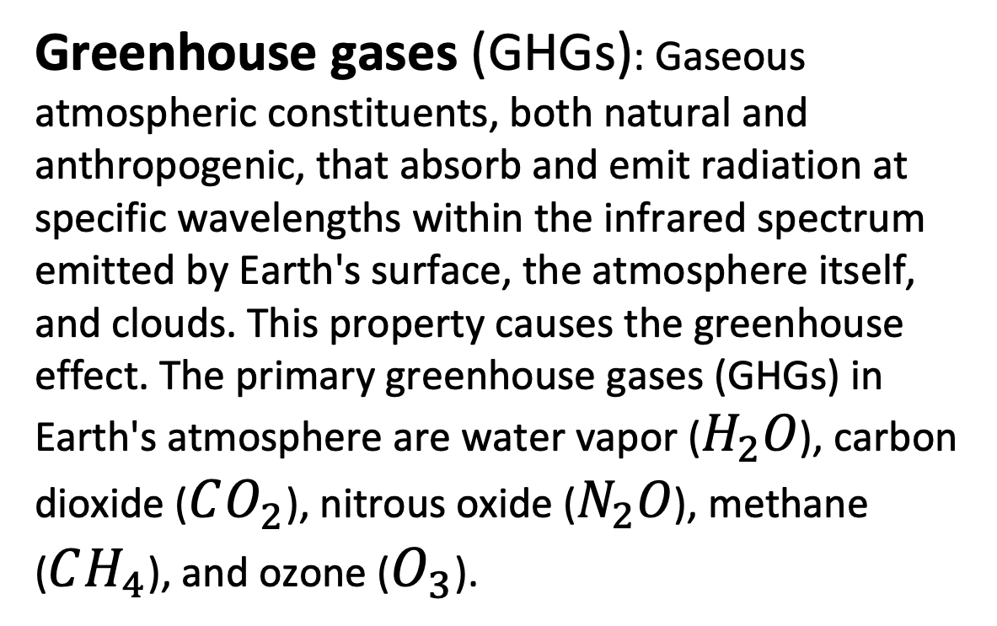
GLOSSARY / FORESTS
Soil organic carbon (SOC): Carbon stored in soil organic matter. Crucial for soil health, fertility, and other ecosystem services, particularly food production. (FAO)
Soil organic matter: Any material originally produced by living organisms (plants or animals) that returns to the soil and undergoes decomposition. At a given time, it consists of a range of materials from original, intact plant and animal tissues to mixtures of substantially decomposed material. (FAO)
Heterotrophic respiration of microorganisms: The process by which organic matter is mineralized by microorganisms. Organic compounds are oxidized into carbon dioxide and water, accompanied by (for aerobic microorganisms) the consumption of oxygen. This parameter is used to quantify microbial activity in soils.
Litter: All non-living biomass with a diameter smaller than the minimum diameter for deadwood (i.e., 10 cm), lying on mineral or organic soil in various states of decomposition. (FAO)
Net primary production (NPP): A fundamental ecosystem characteristic, representing the conversion of carbon dioxide into biomass through photosynthesis, after accounting for plant respiration. It refers to the quantity of organic matter produced by plants in an ecosystem over a given period. Typically expressed in tonnes of carbon per hectare per year (t C ha⁻¹ yr⁻¹). (FAO)
Net ecosystem production (NEP): The portion of NPP that remains in the ecosystem after accounting for respiration by microorganisms and animals. In other terms, it represents gross primary production minus both autotrophic (plant) and heterotrophic (microbial and animal) respiration. When positive, it indicates the quantity of carbon removed from the atmosphere by the ecosystem over a given period. Typically expressed in tonnes of carbon per hectare per year (t C ha⁻¹ yr⁻¹). (IPBES)
1 Gt = 10⁹ tonnes
1 Gt C = 1 Pg C
1 Mt = 10⁶ tonnes
1 Gt C = 3.666 Gt CO₂
IPCC: Intergovernmental Panel on Climate Change
Greenhouse gases (GHGs): Gaseous atmospheric constituents, both natural and anthropogenic, that absorb and emit radiation at specific wavelengths within the infrared spectrum emitted by Earth's surface, the atmosphere itself, and clouds. This property causes the greenhouse effect. The primary greenhouse gases (GHGs) in Earth's atmosphere are water vapor ($H_{2}O$), carbon dioxide ($CO_{2}$), nitrous oxide ($N_{2}O$), methane ($CH_{4}$), and ozone ($O_{3}$).

Slide 4
ECOSYSTEM OVERVIEW: DEFINITIONS AND KEY FIGURES

Slide 5
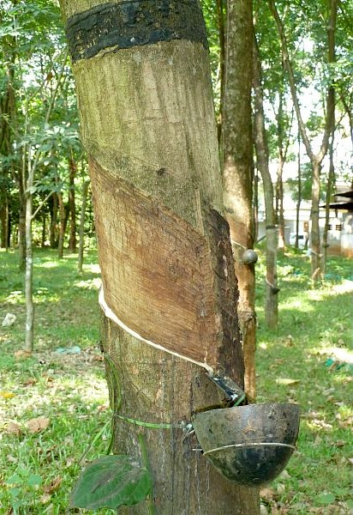

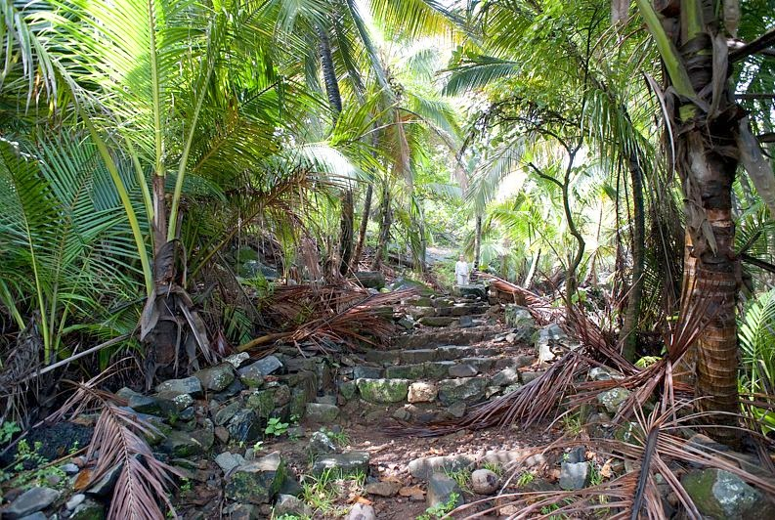
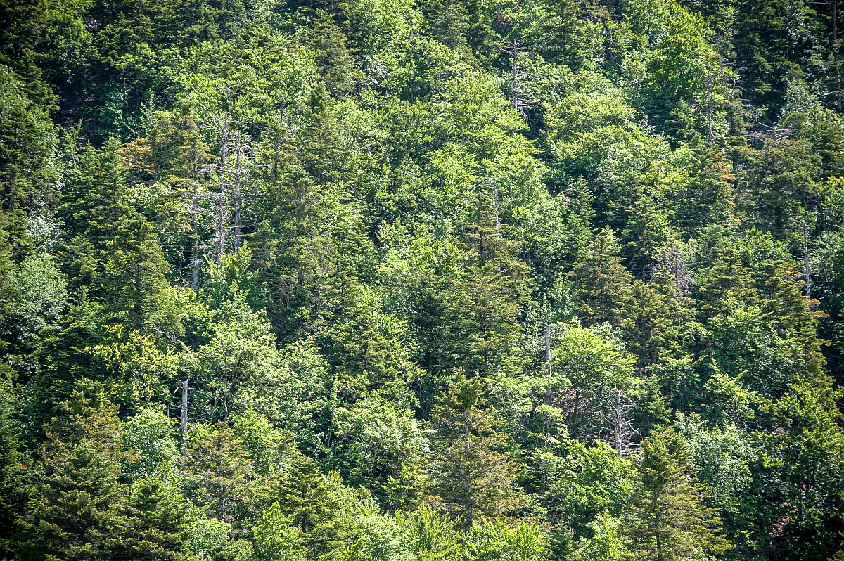
FAO forest definitions
Forest
Land area spanning more than 0.5 hectares with trees reaching heights over 5 meters and a canopy cover exceeding 10%. The definition excludes lands whose predominant use is agricultural or urban.
> 5 m
© INRAE / MAITRE Christophe
© INRAE / NICOLAS Bertrand
© INRAE / LE BASTARD Rémi
Tropical rainforest of French Guiana
Forest on the slopes of Mont Ventoux (French PACA region)
Rubber tree cultivation (India, Kerala region)

Slide 6
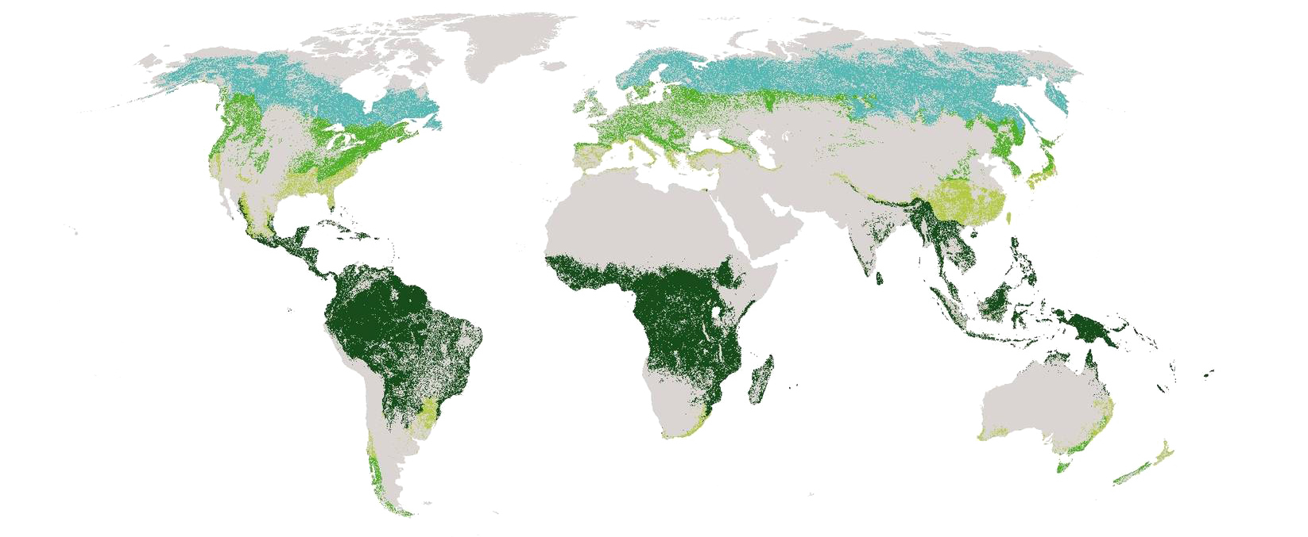




Forests on a global scale
Global forest area (land use)
4 060 million ha
(i.e. 31% of the world's land area)
45%
tropical
27%
boreal
16%
temperate
11%
subtropical
Deforestation rate
between 2015 and 2020
approximately 10 million hectares per year
Proportion and distribution of global forest areas by climatic zone (FAO, 2020)
(adapted from United Nations World map, 2020)
(FAOSTAT, 2020)

Slide 7
Global forest area is decreasing year after year
Share of land area covered by forests
(FAO, 2020, Global forest resources assessment;
Friedlingstein et al., 2023)
Annual net change in forest area, by decade and region, 1990-2020
(FAO, 2020, Global forest resources assessment)

Slide 8
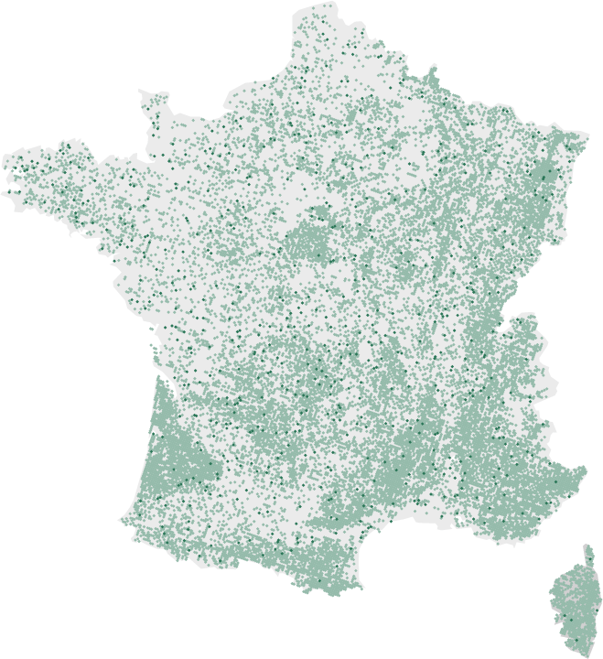
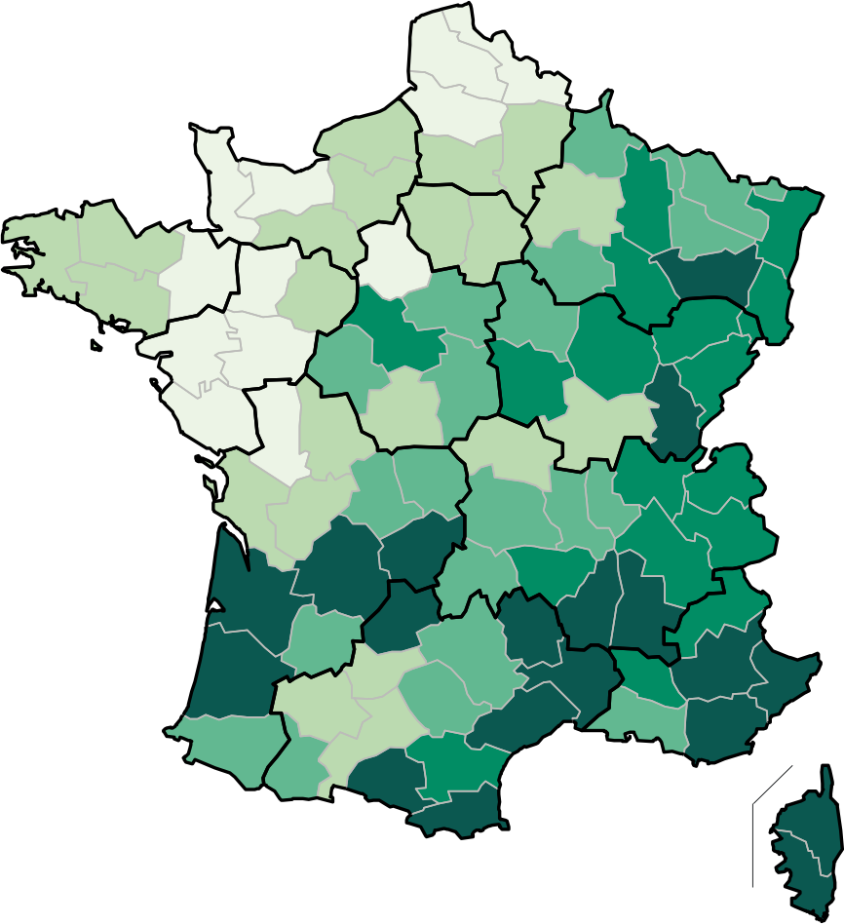
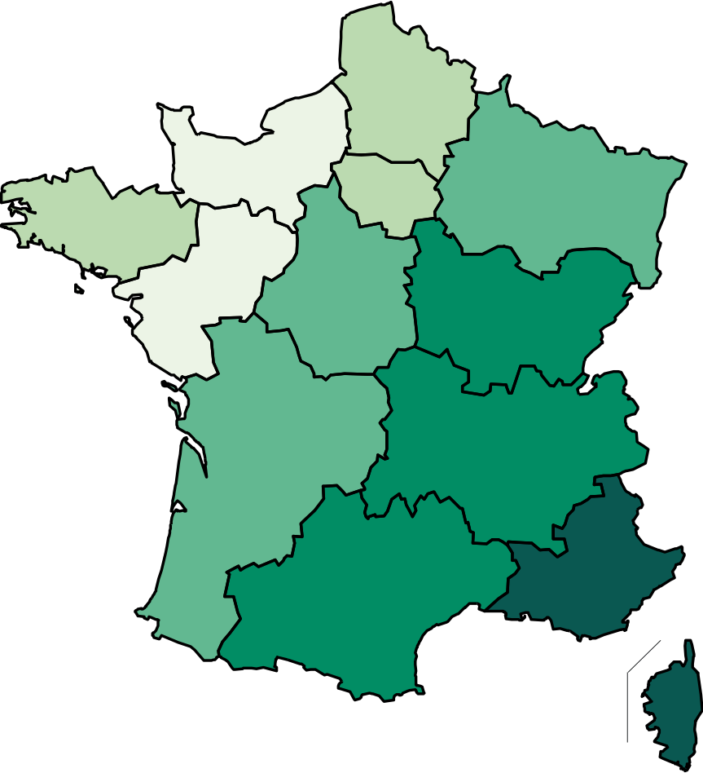





Forests in France
17.5 million hectares
of forests
32%
of the territory
Forest cover rate
75 %
Less than 15%
Between 15 and 25%
Between 25 and 35%
Between 35 and 45%
Over 45%
private forests
25 %
By French department
By French region
public forests
1 – Corse-du-Sud (74%)
2 – Alpes-Maritimes (66%)
3 – Var (65%)
4 – Haute-Corse (64%)
5 – Alpes-de-Haute-Provence (62%)
6 – Ardèche (62%)
...
1 – Corse (69%)
2 – Provence-Alpes-Côte d’Azur (52%)
3 – Occitanie (38%)
4 – Auvergne-Rhône-Alpes (37%)
5 – Bourgogne-Franche-Comté (37%)
6 – Nouvelle-Aquitaine (34%)
...
83%
67%
broadleaf trees
of stands composed of 2 tree species or fewer
(IGN national forest inventory – 2019-2023)

Slide 9

France’s forest area is increasing year after year
17.5
million hectares
The main reasons for this significant growth are primarily attributed to agricultural abandonment and the afforestation of farmland (e.g., Mediterranean regions), and to a lesser extent, climate change, which promotes tree growth and productivity (e.g., French Bretagne)
16.2
million hectares
14.1
million hectares
2023
2010
9.9
million hectares
1985
between
8.9 and 9.5
million hectares
1908
1830
Evolution of forest area in France
(Inventaire forestier national – IGN – 2019-2023)

Slide 10
STOCKS AND FORMS OF ORGANIC CARBON

Slide 11
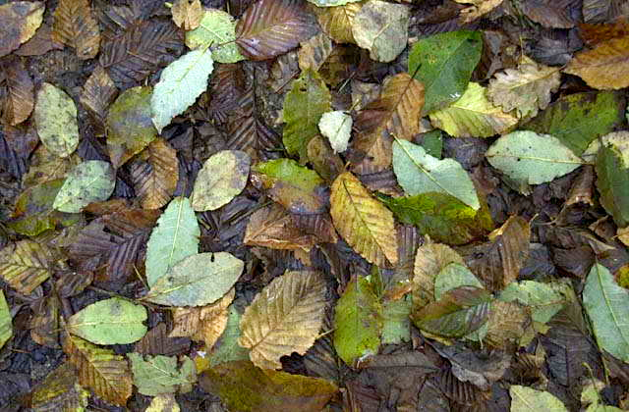
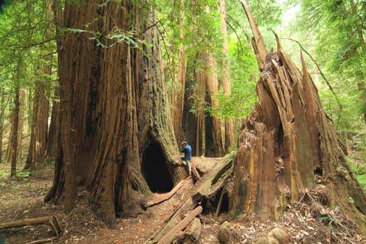
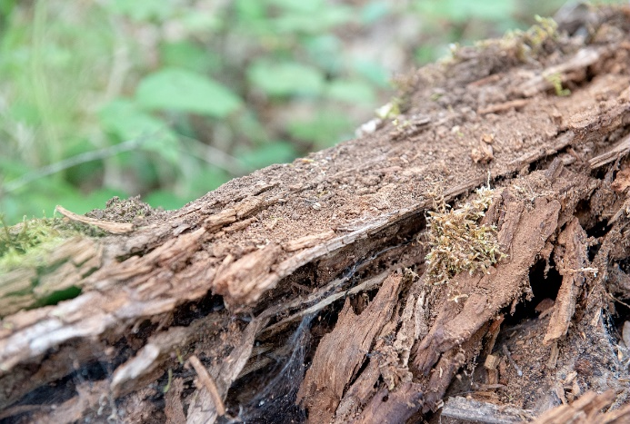

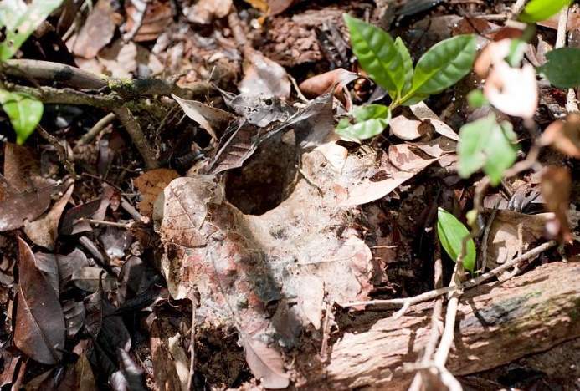
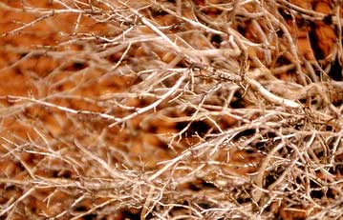
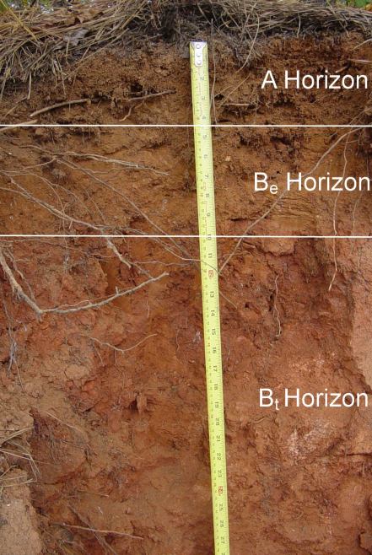
Forest carbon assessment: different stocks
d'après Pan et al., 2011
Leaf biomass
(measurement of leaf area and mass per unit area)
Living biomass:
43% of the C stock
Aboveground biomass
Standing woody biomass
(measured through forest inventory)
Deadwood
(measured by forest inventory)
Deadwood:
8% of the C stock
Litter
(measured by forest inventory)
Litter:
5% of the C stock
Belowground biomass
Root biomass
(measured by excavation)
Soil Organic Matter (SOM)
(measured by assay and density)
© INRAE / NICOLAS Bertrand,
MAITRE Christophe
Soil (to 1 m depth):
45% of the C stock
www.pepr-faircarbon.fr

Slide 12
Recent evolutions of C stocks in different forest biomes
The majority of global forest carbon stock is in tropical forests (54%).
Tropical primary forests are experiencing a decline in carbon stocks, while increases have been noted in secondary tropical forests, as well as in temperate and boreal forests.
Total carbon stock by biome
(Pan et al., 2024)

Slide 13
Forest organic carbon stocks
 | Global | Continental France
Forest area | 4.17 x 10⁹ ha (1/3 of the world’s land surface) | 17.5 x 10⁶ ha (32% of mainland territory)
Total C stock per unit area | 275 tC.ha⁻¹ | 83 tC.ha⁻¹
C stock in soil | 787 Gt C _{(0 - 1 m)} | 1 405 Mt C _{in 2010 (0 - 30 cm)}
C stock in biomass | 359 Gt C | 1 296 Mt C _{in 2010}
Total C stock | 1 146 Gt C | 2.8 Gt C
Data source | IPCC SRES Land-Use 1998 | IGN national forest inventory
In France’s European territory, forests account for nearly 40% of soil carbon stocks.
13

Slide 14
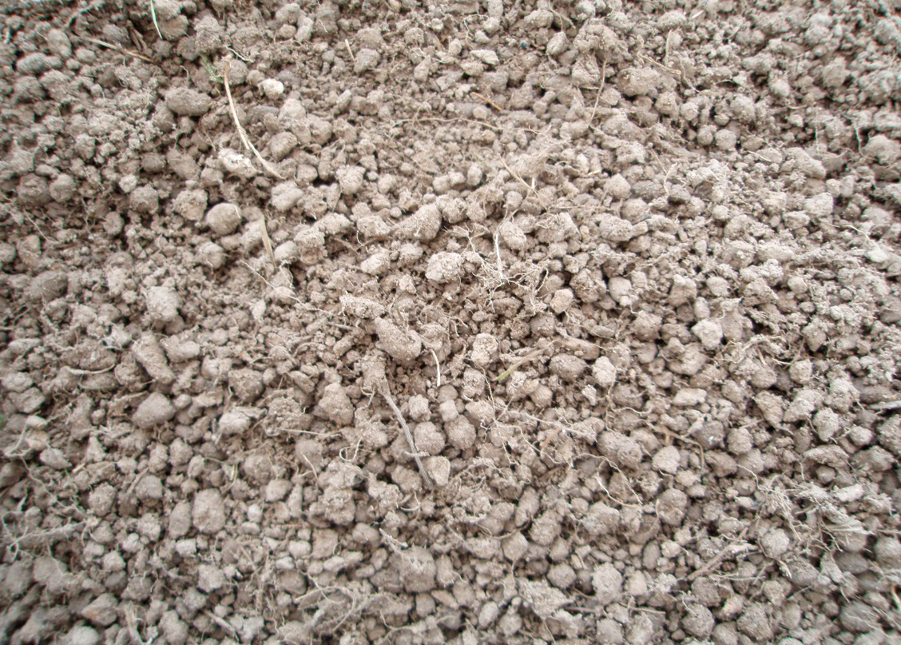
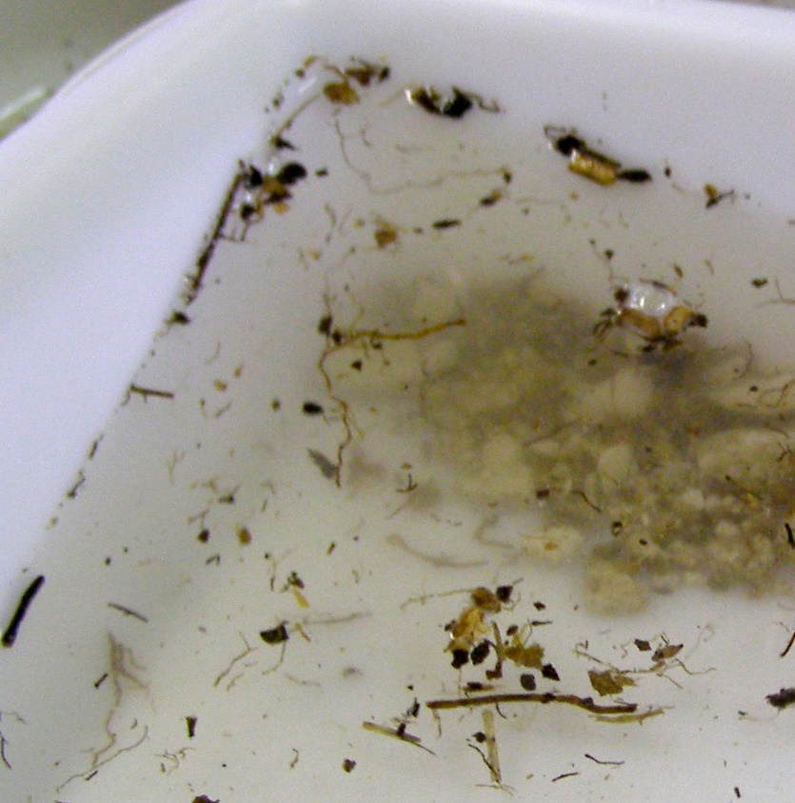
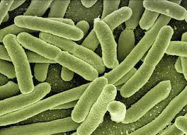
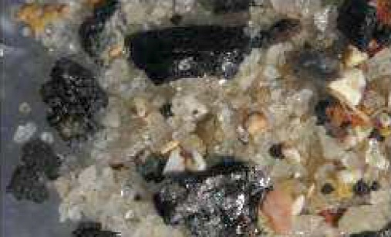
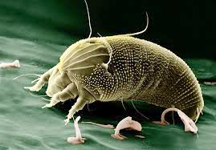
Different forms of organic carbon in soils
Mineral-associated organic matter derived from plant/microbial biomass, contributing to soil darkening.
∼60–95%
Decomposing plant debris (floating in water due to low density).
∼5–30%
© DURAND Hermine
© DURAND Hermine
Living organic matter.
∼1–5%
Pyrogenic organic matter.
∼5–30%
© CHASSÉ Matthieu
+
+ dissolved organic carbon
< 1%
European Atlas of Soil Biodiversity (2013)

Slide 15
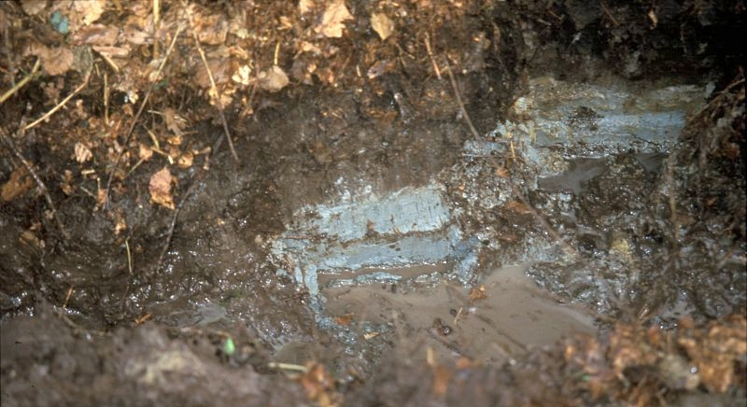
Vertical distribution of organic carbon in forests
Gley-type soil profile in the Fougères forest (Ille-et-Vilaine, France)
Distribution profile of organic carbon in forest soils
More carbon at the surface, but it’s present at depth too!
© INRAE / TROLARD-STOLL Fabienne
Brown bars indicate the proportional distribution of total organic carbon in the first soil meter in 20-cm intervals. Gray bars indicate the proportion of additional carbon in the 100–200 cm and 200–300 cm layers.
Approximately 60% of organic carbon is stored in the first soil meter, of which 50% is in the 0-20 cm layer.
(Jobbagy & Jackson, 2000)

Slide 16
Organic carbon flows

Slide 17



General carbon flow diagram in forests
CO₂
C INPUTS (∼122 Pg C)
Photosynthesis
Partitioning of photo-assimilates
1
2
Litter
According to Chapin et al., 2002

Slide 18




General carbon flow diagram in forests
CO₂
C INPUTS (∼122 Pg C)
Photosynthesis
Partitioning of photo-assimilates
1
2
Soil organic matter is broken down by microbial enzymes into small soluble molecules that can be absorbed by microorganisms. The ingested carbon serves as a source of both materials (for microbial synthesis) and energy (through heterotrophic respiration).
Litter
Biotransformations
(microbial synthesis, depolymerization)
Transfers
(bioturbation, convection etc.)
According to Chapin et al., 2002

Slide 19
General carbon flow diagram in forests
C OUTPUTS
Autotrophic respiration,
(leaves, wood, roots) (∼60 Pg C)
Heterotrophic respiration (microorganisms and fauna) (∼60 Pg C)
Decay
Biomass export
CO₂
CO₂
C INPUTS (∼122 Pg C)
Photosynthesis
Partitioning of photo-assimilates
4
1
1
2
3
Soil organic matter is broken down by microbial enzymes into small soluble molecules that can be absorbed by microorganisms. The ingested carbon serves as a source of both materials (for microbial synthesis) and energy (through heterotrophic respiration).
Carbon exits soils primarily as , derived from autotrophic respiration by trees and heterotrophic respiration from soil microorganisms and fauna.
Litter
2
Biotransformations
(microbial synthesis, depolymerization)
Transfers
(bioturbation, convection etc.)
According to Chapin et al., 2002

Slide 20

Mechanisms of organic matter stabilization in soils
Selective Preservation
Recalcitrance
Interaction with Ions or Mineral Surfaces
Physical Protection
Environmental Conditions for Microorganisms
Macro-molecules
Pyrogenic Carbon
Complexation
Adsorption
Inaccessibility, Local Physical Conditions
The rate at which organic matter can be degraded depends on its chemical composition, its interaction with the mineral phase, its accessibility to microorganisms, and environmental conditions.
according to Chenu et al., 2009, CMS series

Slide 21

General summary diagram of forest carbon flows
122 Pg C
NPP: Net Primary Production
GPP: Gross Primary Production
NEP: Net Ecosystem Production
Emissions: Plants also release carbon to the atmosphere through emission of volatile organic compounds or by combustion in fires.
R_{plant}: Roots and aboveground portions of plants return carbon to the atmosphere as plant respiration
R_{heteroth}: Heterotrophic respiration (microorganisms and animals)
F_{disturb}: Carbon can be removed from vegetation by human harvest or other disturbances
F_{lixiviation}: Carbon leaches from ecosystems in dissolved and particulate forms and moves laterally through erosion and deposition of soil, movement of animals, etc.
R_{plant}
GPP
60 Pg C
F_{disturb}
R_{heteroth}
Plants
Litter
Animals
60 Pg C
Soil organic matter and microbes
F_{lixiviation}
NPP = GPP – R_{plant}
NEP ≈ GPP – (R_{plant} + R_{heteroth} + F_{disturb} + F_{lixiviation} )
according to Chapin et al., 2002

Slide 22
General summary diagram of forest carbon flows
122 Pg C
R_{plant}
GPP
The global forest carbon sink (= stock increase, via fluxes) is not known with certainty:
Pan et al., 2024
(inventories, 1990-2019):
1.3 ± 0.6 Gt C/yr
Harris et al., 2021
(remote sensing + inventories, 2011-2019) :
2.1 ± 13 Gt C/yr
60 Pg C
F_{disturb}
R_{heteroth}
Plants
Litter
Animals
60 Pg C
Soil organic matter and microbes
F_{lixiviation}
according to Chapin et al., 2002

Slide 23



Different fluxes depending on biome
TROPICAL
TEMPERATE
BOREAL
GPP
R_{autotrophic}
The largest forest carbon stock is in tropical forests (54%).
GPP
R_{autotrophic}
GPP
R_{autotrophic}
R_{heterotrophic}
R_{heterotrophic}
R_{heterotrophic}
45% of the forest C sink
+ 2.53 (tree growth) – 2.24 (deforestation) = + 0.29 Gt C/yr
33% of the forest C sink
+ 0.6 Gt C/yr
27% of the forest C sink
+ 0.44 Gt C/yr
Total forests = 0.29 + 0.6 + 0.44 = + 1.33 Gt C/yr
The main net land carbon sink is in tropical forests.
Currently, temperate forests absorb more carbon than tropical forests. In other words, the carbon stock of temperate forests is increasing faster than that of tropical forests (which only grows because of expanding young tropical forests; primary tropical forests are declining due to deforestation). Without deforestation, tropical forests would far surpass all others as the largest land carbon sink (by themselves, undisturbed tropical forests sequester as much carbon as all temperate and boreal forests combined).
Reminder: NEP = GPP – R_{heterotrophe} – R_{autotrophe}
NEP_{tropical} > NEP_{temperate} > NEP_{boreal} (Anderson-Teixeira et al., 2021)

Slide 24
Organic carbon dynamics in forests and global changeS

Slide 25
Carbon dynamics vary across biomes
Boreal forests
∼2-3 tree species per hectare
Short vegetation activity period (long winters)
Slow nutrient cycling
Low productivity but organic matter accumulation in soils
Temperate forests
∼10-15 tree species per hectare
Intermediate-length vegetation activity period (winter frost risk)
Intermediate biomass and productivity
Tropical forests
∼50-250 tree species per hectare (maximal biodiversity)
Continuously active vegetation (but potential dry season)
Rapid nutrient cycling, nutrient-poor soils
Maximal biomass and productivity
45%
tropical
27%
boreal
16%
temperate

Slide 26
Average carbon residence time in forests
Biome | Mean residence time in the plant-soil system (years)
 | Biomass | Soil and litter
Boreal forests | 12 | 106
Temperate forests | 10 | 10
Tropical forests | 16 | 15
according to Malhi et al., 1999

Slide 27
Carbon storage dynamics in mature forests
Without major disturbances (drought, defoliation, fire, etc.), old-growth/mature forests remain carbon sinks (no saturation of the sink despite forest age)!!!
Odum’s (1967) hypothesis predicts that old forests reach a state of equilibrium between carbon uptake and emissions. This would mean that old-growth forests are carbon neutral.
This hypothesis has now been refuted: old-growth forests can continue to accumulate carbon! (Luyssaert et al., 2008; Besnard et al., 2021)

Slide 28
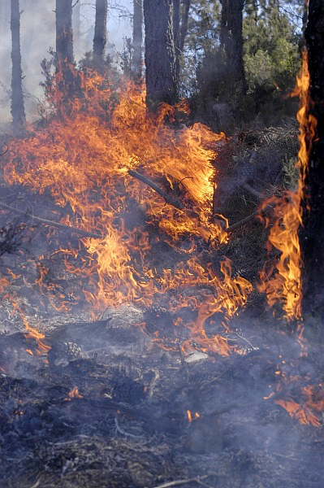
Anthropogenic effects on forest ecosystems
Risks of ecosystem carbon loss:
Wildfires
Increased forest management intensity (heavy thinning and clear-cutting) to meet bioeconomy and renewable energy demands.
Agricultural expansion, the main driver of deforestation.
Forests sequester a significant portion (around 20%) of human CO₂ emissions annually, despite ongoing deforestation, which reduces global forest area year after year. Without ongoing deforestation, forests' contribution to offsetting our emissions would be even greater. Deforestation thus worsens global warming in two ways:
1. By directly emitting CO₂ (burning of wood and decomposition of soil organic matter; short- or long-term combustion or decomposition of wood products from deforestation)
2. By reducing the area of forests able to absorb CO₂ from the atmosphere and store it as organic matter.
© INRAE / MAITRE Christophe
Controlled burning, a method used to limit the spread of wildfires

Slide 29
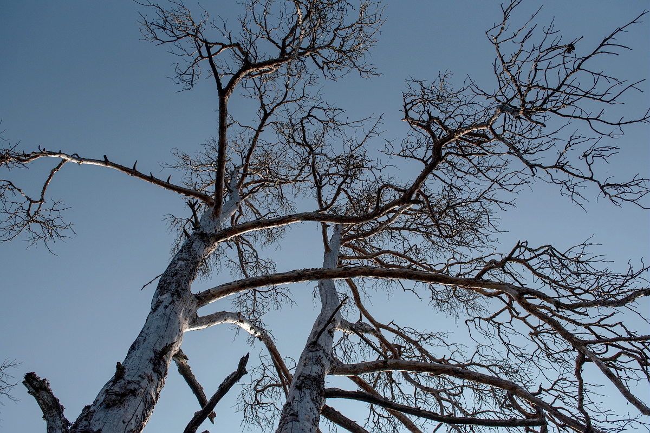
Effects of climate change on forest ecosystems
Antagonistic effects of climate change:
Forests growing faster
Fertilization effects from increased atmospheric CO₂ and nitrogen deposition (indirect anthropogenic effects). However, enhanced photosynthesis remains limited by nutrient and water availability; responses vary by climate region (importance of co-limitations).
Longer growing seasons
© INRAE / NICOLAS Bertrand
Tree mortality due to drought and water stress
More vulnerable forests
Accelerated decomposition rate of soil organic matter (biogeochemical aspect)
Increased droughts and heatwaves (biophysical aspect)
Proliferation of diseases and forest pests (biological aspect)
Rising water stress may disrupt forests' water-use efficiency
Increased frequency, intensity, and duration of wildfires (including longer fire seasons)

Slide 30
LEVERS FOR CARBON STORAGE in forests

Slide 31
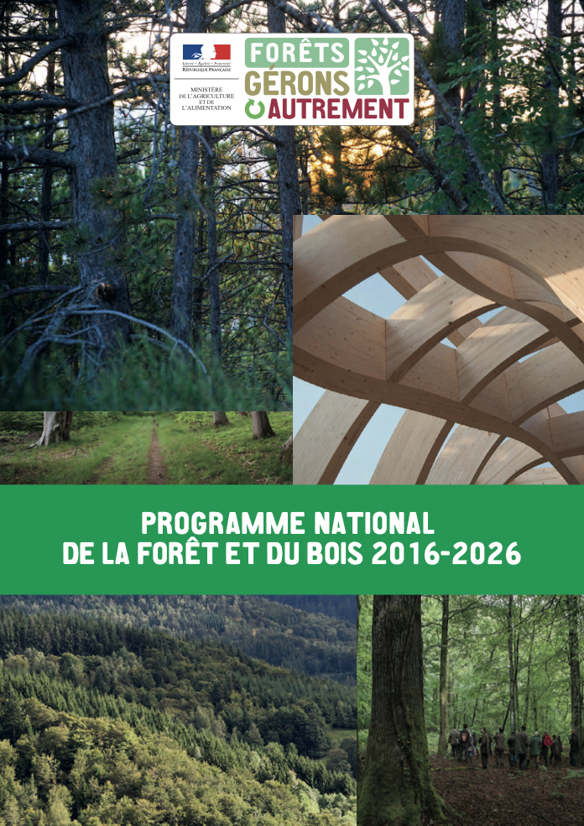
Forests in the SNBC (National Low-Carbon Strategy)
"The forest-wood sector is a pillar of France's green growth. It offsets approximately 20% of France's CO₂ emissions through carbon storage in forests (soils and aboveground biomass), in wood products, and by substituting fossil fuels and more energy-intensive materials.
This sector is central to major societal challenges and plays a key role in climate, ecological, and energy transitions."
(National Forest and Wood Program 2016-2026)
BUT
French forests are losing momentum in carbon storage:
The carbon sequestration rate has fallen by half in 10 years (CITEPA data), largely due to increased tree mortality.

Slide 32
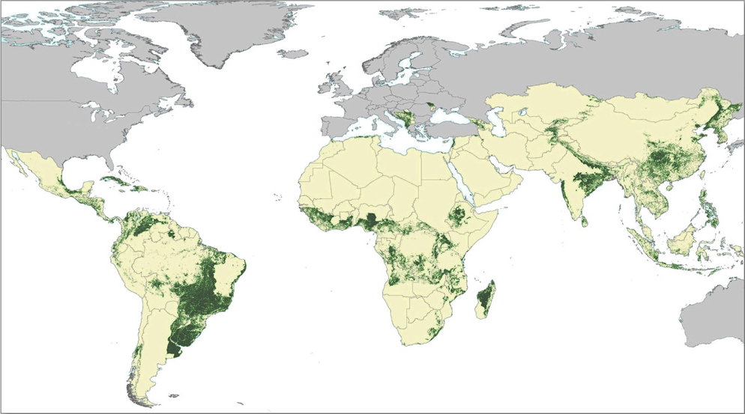
Storage-enhancing practices for forests?
Practices to enhance carbon storage in forest ecosystems:
Reforestation & afforestation
Agroforestry
Sustainable forest management: selective logging, reducing deforestation rates
Protection of primary (old-growth) forests
Practices to enhance carbon storage in forest soils:
Preserving & managing soil organic matter: mulching & composting, adding organic residues
Using adapted tree species
Minimizing soil disturbance (avoiding compaction from heavy machinery, limiting tillage/laboring)
Restoring degraded soils
Map of Lands Suitable for Clean Development Mechanism - Afforestation/Reforestation (An economic carbon finance mechanism established under the Kyoto Protocol) - dark green areas - Based on land suitability analysis by Zomer et al. (2008).
(per 4p1000 Initiative & IPCC AR6 WGIII Chapter 7 reports)
Global maximum average carbon sequestration rate: 1.1–1.6 Gt C/year for above- and belowground biomass
(IPCC SR-LULUCF 2000, Brown et al., 1996)
(IPCC SR-LULUCF 2000, Brown et al., 1996)

Slide 33
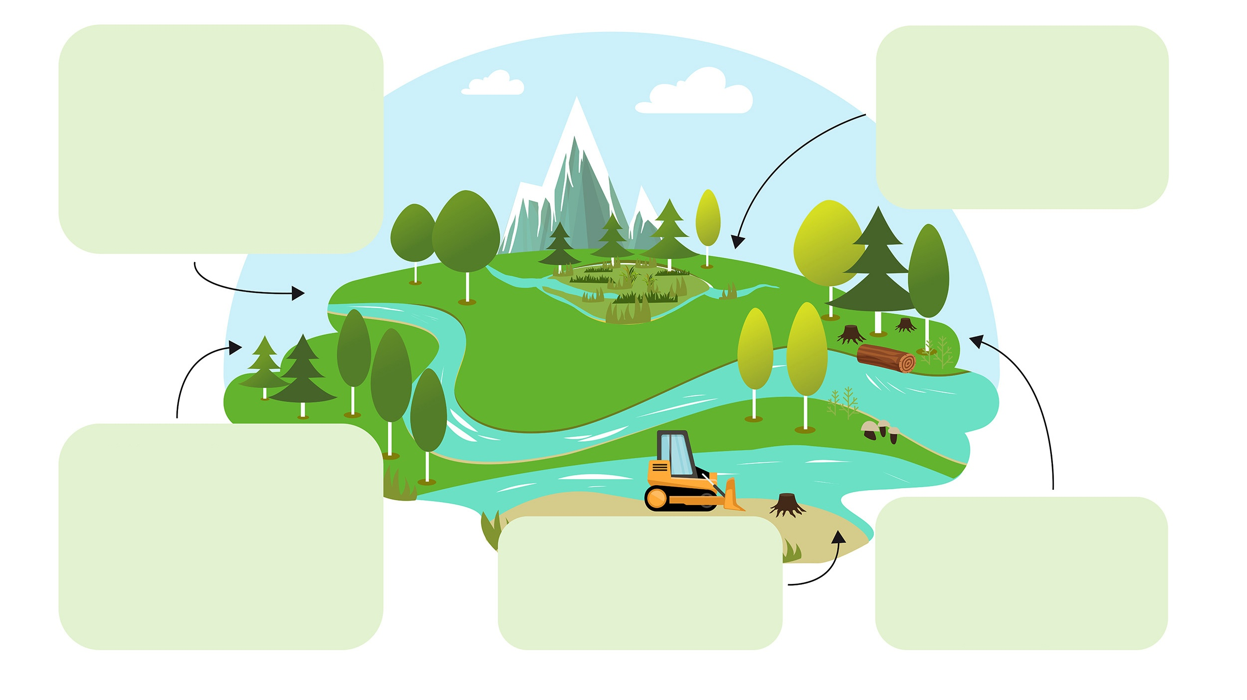
Forest soils can contribute to climate change mitigation through targeted management practices that enhance soil carbon stocks
1. Nutrient management
4. Forestry peatland hydrology management
(High water-table level)
Management practices affect soil carbon stocks and CO₂, CH₄, and N₂O emissions in temperate and boreal forests.
Green arrows indicate positive impacts for climate change mitigation; orange arrows indicate negative impacts for climate change mitigation.
Soil carbon stock
emissions
CO₂ CH₄ N₂O
Nitrogen fertilization in boreal forests
Wood ash fertilization
Soil carbon stock
emissions
CO₂ CH₄ N₂O
2. Forest stand management
Increase
Decrease
Soil carbon stock
emissions
CO₂ CH₄ N₂O
5. Biodiversity management
3. Tillage
No net effect
No data
Tree species selection
Thinning and timber harvesting
Soil carbon stock
emissions
CO₂ CH₄ N₂O
Soil carbon stock
emissions
CO₂ CH₄ N₂O
(Mäkipää et al., 2023)

Slide 34



Plantations vs. natural regeneration of the same tree species
?
Which species will best meet future climate constraints and societal expectations?
Plantations generally lead to reductions in biodiversity, particularly at the expense of native species…
…But it is not always possible or desirable to favor natural regeneration dynamics, especially if the goal is to change tree species to reduce future disturbance risks.
Controversial aspects of different cutting methods for forest regeneration, particularly clear-cutting (increased risk of soil erosion, compaction, disruption of soil chemical fertility, reduction in fungal communities, elimination of many healthy individuals during clear-cutting of plots containing 20% of stems in poor health...)
(Collective Expertise CRREF 2023)

Slide 35
Carbon storage in forest soils isn't just a biophysical matter!
Technical carbon storage potential: The additional storage level achievable (accounting for biophysical limits) by implementing all technically feasible actions on a territory's lands.
Technical potential
Difference between the technically achievable carbon storage, and the socio-politically achievable carbon storage
  Economic limits: Implementing carbon-storing practices typically incurs additional costs. If these costs are prohibitive or if no support is provided for adopting such practices, the economic storage potential may fall far short of the technical potential.
Economic limit
Maximal carbon sequestration potential
Socio-political limit
  Social limits: Even with adequate economic support, the adoption of carbon-storing practices may face resistance from various social stakeholders.
0
(Based on Amundson & Biardeau PNAS 2018)
A balance to strike between energy priorities (harvesting for wood energy; energy used for tree harvesting) and sustainability (soil nutrient export; reduction in carbon storage, soil fertility, and soil biodiversity).

Slide 36
Conclusions

Slide 37

Key points to remember
In mainland France and Corsica, forests represent about one-third of the territory and almost 40% of soil carbon stocks.
Carbon content in forest soils decreases with depth.
Forests represent one-third of global land areas.
@
Global forest area is decreasing, mainly due to deforestation in tropical regions.
Carbon enters the forest ecosystem through photosynthesis; the main carbon outputs are autotrophic respiration (plant), heterotrophic respiration (microorganisms and fauna), and biomass export.
In forest ecosystems, carbon is stored ∼50 % in the soil and ∼50 % in the biomass.

Slide 38
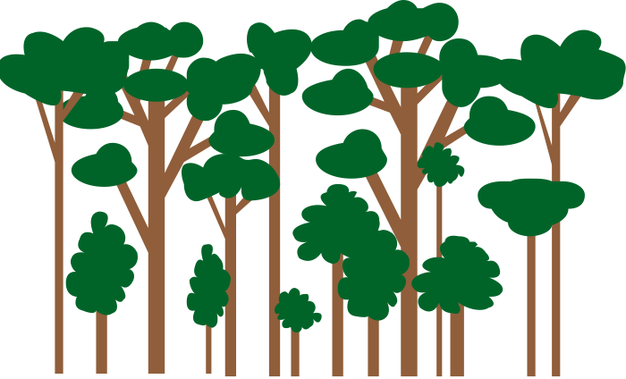


Key points to remember
Chemical fertility and soil carbon are intimately linked:
intensive harvesting
=> decrease in soil C
  => loss of fertility
    => decreased growth.
Therefore, soil C must be cared for at the same time as chemical, physical, and biological fertility.
To preserve existing carbon stocks in forests, it is essential to avoid deforestation.
CO₂
In the context of storing carbon, the levers for action on forests are extremely limited. The priority is to maintain existing stocks.
Climate change has antagonistic effects on forests: forests grow faster but are more vulnerable.

Slide 39
SOURCES / FORESTS
Presentation of the ecosystem: definitions and key figures
https://www.fao.org/4/ad665e/ad665e03.htm
FAO. 2020. Global Forest Resources Assessment 2020: Main report. Rome, 166 p. https://www.fao.org/interactive/forest-resources-assessment/2020/en/
Institut Géographique National (IGN). (2024). Inventaire forestier national - Mémento. 72 p. https://inventaire-forestier.ign.fr/IMG/pdf/memento_2024.pdf
Stocks and forms of organic carbon
Pan Y. et al. (2011). A Large and Persistent Carbon Sink in the World's Forests. Science 333: 988-993. https://doi.org/10.1126/science.1201609
Harris N.L., Gibbs D.A., Baccini A. et al. (2021). Global maps of twenty-first century forest carbon fluxes. Nature Climate Change 11: 234-240. https://doi.org/10.1038/s41558-020-00976-6
INRAE Étude 4 pour 1000, Résumé en français. 11 p. https://www.inrae.fr/sites/default/files/pdf/etude-4-pour-1000-resume-en-francais-pdf-1_0.pdf
Jobbágy E.G. & Jackson R.B. (2000). The vertical distribution of soil organic carbon and its relation to climate and vegetation. Ecological Applications 10: 423-436.
https://doi.org/10.1890/1051-0761(2000)010[0423:TVDOSO]2.0.CO;2
IPCC (2000). Summary for Policymakers. Land Use, Land-Use Change, and Forestry. 24 p. https://www.ipcc.ch/site/assets/uploads/2018/03/srl-en-1.pdf
Institut Géographique National (IGN). (2020). État et évolution des forêts françaises métropolitaines. Indicateurs de gestion durables 2020. 307 p. https://foret.ign.fr/api/upload/IGD-2020-c255.pdf
Pan Y. et al. (2024). The enduring world forest carbon sink. Nature 631: 563-569. https://doi.org/10.1038/s41586-024-07602-x
Organic carbon flows
Craine J.M., Froehle J., Tilman D.G., Wedin D.A. & Chapin, III, F.S. (2001). The relationships among root and leaf traits of 76 grassland species and relative abundance along fertility and disturbance gradients. Oikos 93(2): 274-285.
https://doi.org/10.1034/j.1600-0706.2001.930210.x
Chenu C., Virto I., Plante A. & Elsass F. (2009). Clay-Size Organo-Mineral Complexes in Temperate Soils: Relative Contributions of Sorptive and Physical Protection. CMS Workshop Lectures 16: 120-135. https://doi.org/10.1346/CMS-WLS-16
Anderson-Teixeira K.J., Herrmann V., Banbury Morgan R., Bond-Lamberty B., Cook-Patton S.C., Ferson A.E., Muller-Landau H.C. & Wang M.M.H. (2021). Carbon cycling in mature and regrowth forests globally. Environmental Research Letters 16, 21 p. https://doi.org/10.1088/1748-9326/abed01
Organic carbon dynamics in forests and global changes
Malhi Y., Baldocchi D.D. & JARVIS P.G. (1999). The carbon balance of tropical, temperate and boreal forests. Plant, Cell & Environment 22: 715-740.
https://doi.org/10.1046/j.1365-3040.1999.00453.x
Luyssaert S., Schulze E.D., Börner A. et al. (2008). Old-growth forests as global carbon sinks. Nature 455: 213-215. https://doi.org/10.1038/nature07276
Besnard S., Koirala S., Santoro M., Weber U., Nelson J., Gütter J., Herault B., Kassi J., N'Guessan A., Neigh C., Poulter B., Zhang T. & Carvalhais N. (2021). Mapping global forest age from forest inventories, biomass and climate data. Earth System Science Data 13: 4881-4896. https://doi.org/10.5194/essd-13-4881-2021
Nabuurs G-J., Mrabet R., Abu Hatab A., Bustamante M., Clark H., Havlík P., House J., Mbow C., Ninan K.N., Popp A., Roe S., Sohngen B. & Towprayoon S. (2022). Agriculture, Forestry and Other Land Uses (AFOLU). In : IPCC. Climate Change 2022 - Mitigation of Climate Change. Contribution of Working Group III to the Sixth Assessment Report of the Intergovernmental Panel on Climate Change. 747-860. https://www.ipcc.ch/report/ar6/wg3/downloads/report/IPCC_AR6_WGIII_Chapter07.pdf

Slide 40
SOURCES / FORESTS
Levers for carbon storage in forests
PNF 2016-2026. https://agriculture.gouv.fr/le-programme-national-de-la-foret-et-du-bois-2016-2026
Citepa, 2024. Rapport Secten – Emissions de gaz à effet de serre et de polluants atmosphériques 1990-2023. 560 p. https://www.citepa.org/wp-content/uploads/2024/12/Citepa_Secten-2024.pdf
Pellerin S. & Bamière L. (pilotes scientifiques), Launay C., Martin R., Schiavo M., Angers D., Augusto L., Balesdent J., Basile-Doelsch I., Bellassen V., Cardinael R., Cécillon L., Ceschia E., Chenu C., Constantin J., Darroussin J., Delacote P., Delame N., Gastal F., Gilbert D., Graux A.-I., Guenet B., Houot S., Klumpp K., Letort E., Litrico I., Martin M., Menasseri S., Mézière D., Morvan T., Mosnier C., Roger-Estrade J., Saint-André L., Sierra J., Thérond O., Viaud V., Grateau R., Le Perchec S., Réchauchère O. (2020). Stocker du carbone dans les sols français, Quel potentiel au regard de l'objectif 4 pour 1000 et à quel coût ? Rapport scientifique de l'étude, INRA (France), 540 p. https://www.inrae.fr/sites/default/files/pdf/Rapport%20Etude%204p1000.pdf
Zomer R.J., Trabucco A., Bossio D.A. & Verchot L. (2008). Climate Change mitigation: A spatial analysis of global land suitability for clean development mechanism afforestation and reforestation. Agriculture, Ecosystems & Environment 126: 67-80. https://doi.org/10.1016/j.agee.2008.01.014
Brown S., Sathaye J., Cannell M. & Kauppi P. E. (1996). Mitigation of carbon emissions to the atmosphere by forest management. The Commonwealth Forestry Review 75(1): 80-91. https://www.jstor.org/stable/42607279
IPCC (2000). Summary for Policymakers. Land Use, Land-Use Change, and Forestry. 24 p. https://www.ipcc.ch/site/assets/uploads/2018/03/srl-en-1.pdf
Landmann G., Delay M., Marquet G. (coord.), Bergès L., Collet C., Deuffic P., Gosselin M., Marage D., Ogée J., Ose K., Perrier C. (pilotes), Agro C., Akroume E., Aubert M., Augusto L., Baubet O., Becquey J., Belouard T., Boulanger V., Bourdin A., Boutte B., Bouwen K., Brault S., Brunet Y., Bureau F., Castro A., Chaumet M., Conche J., Darboux F., Depeige L., Desgroux A., Dokhelar T., Domec J.-C., Dumas Y., Duprez M., Frappart F., Garcia S., Gardiner B., Girard S., Gosselin F., Husson C., Jacomet E., Jactel H., Joyeau C., Lacombe E., Laurent L., Legout A., Lelasseur L., Lousteau D., Meredieu C., Moreews L., Orazio C., Peyron J.-L., Pilard-Landeau B., Pitaud J., Planells M., Plat N., Ponette Q., Pousse N., Prévosto B., Puiseux J., Puyal M., Ranger J., Richou E., Rigolot E., Riou-Nivert P., Saïd S., Saintonge F.-X., Serra Diaz J. -M., Stemmelen A., Toutchkov M., van Halder I., Vincenot L., Wurpillot S. (experts). 2023. Expertise collective CRREF «Coupes Rases et REnouvellement des peuplements Forestiers en contexte de changement climatique », Synthèse de l'expertise, Paris : GIP ECOFOR, RMT AFORCE, 128 p. http://www.gip-ecofor.org/wp-content/uploads/2023/10/CRREF_rapport-de-synthese_WEB2.pdf
Amundson R. & Biardeau L. (2018). Soil carbon sequestration is an elusive climate mitigation tool. Proc. Natl. Acad. Sci. U.S.A. 115(46): 11652-11656. https://doi.org/10.1073/pnas.1815901115
Mäkipää R., Abramoff R., Adamczyk B., Baldy V., Biryol C., Bosela M., Casals C., Curiel Yuste J., Dondini M., Filipek S., Garcia-Pausas J., Gros R., Gömöryová E., Hashimoto S., Hassegawa M., Immonen P., Laiho R., Li H., Li Q., Luyssaert S., Menival C., Mori T., Naudts K., Santonja M., Smolander A., Toriyama J., Tupek B., Ubeda X., Verkerk P.J. & Lehtonen A. (2023). How does management affect soil C sequestration and greenhouse gas fluxes in boreal and temperate forests? – A review. Forest Ecology and Management 529, 120637. https://doi.org/10.1016/j.foreco.2022.120637

